Slide 1
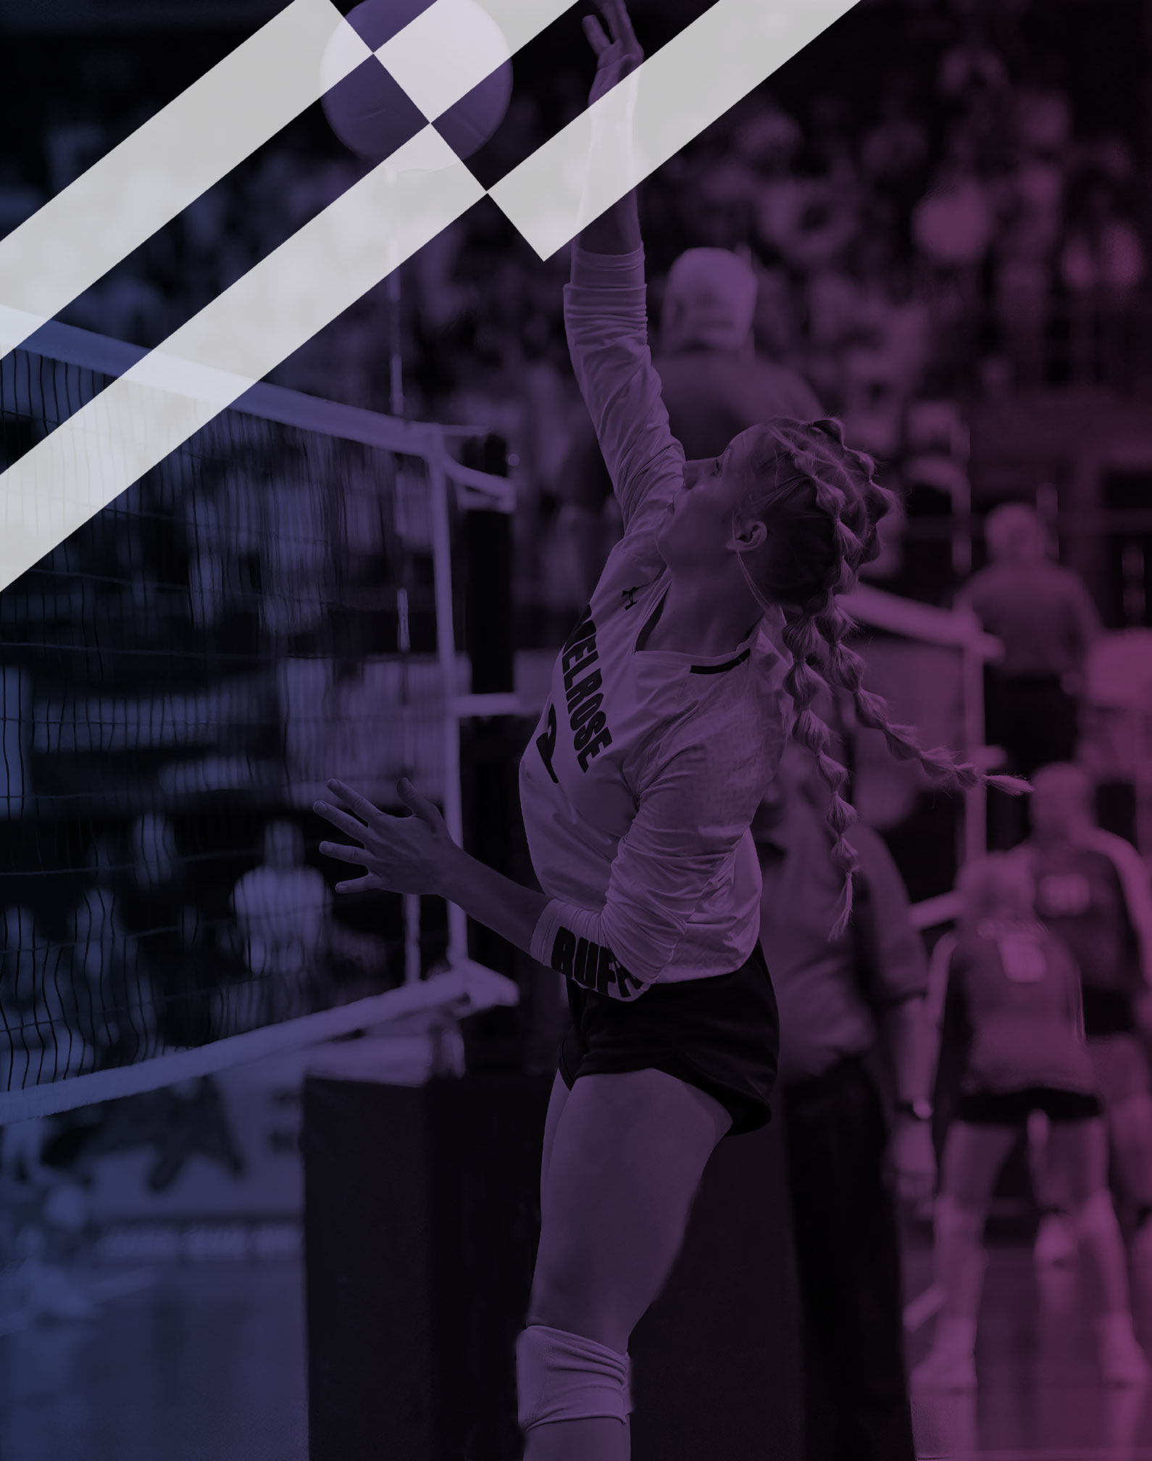
2026-27 NFHS Volleyball Rules PowerPoint
Rules Changes
Editorial Changes
Points of Emphasis

Slide 2

Sponsor Slide
remove this text and place artwork centered here

Slide 3
NFHS Information

Slide 4
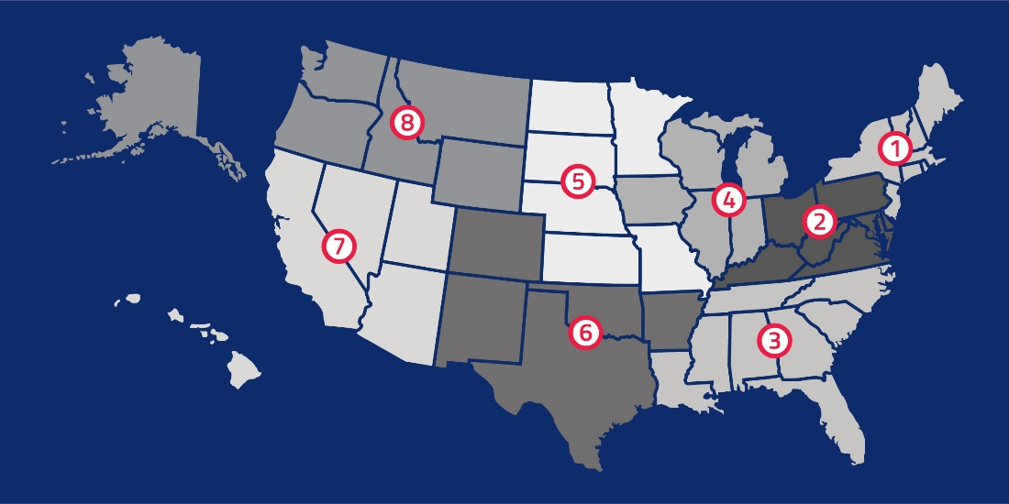
NFHS
NFHS (located in Indianapolis, IN – Est. 1920):
  National leader and advocate for high school
  athletics and performing arts programs.
  Serves 51 state associations, 19,983 high
  schools and 12 million student participants.
  Writes playing rules for 18 high school
  sports for boys and girls.
  Offers online education courses for high
  school coaches, officials, parents, students and others.
  Ensures that students have opportunity to enjoy healthy participation, achievement and good sportsmanship in education-based activities.
Notes:
NFHS (located in Indianapolis, IN – Est. 1920):
National leader and advocate for
high school athletics and
performing arts programs.
Serves 51 state associations, 19,983
high schools and 12 million student
participants.
Writes playing rules for 18 high school
sports for boys and girls.
Offers online education courses for high school coaches,
officials, parents, students and others.
Ensures that students have opportunity to enjoy healthy participation, achievement and good sportsmanship in education-based

Slide 5





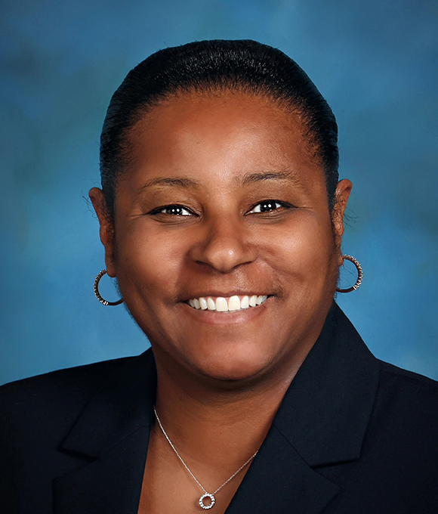

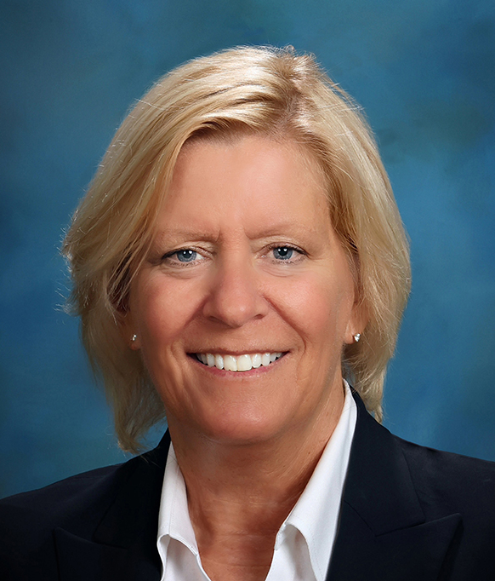

NFHS Rules Review Committee
The NFHS Rules Review Committee is chaired by the chief operating officer and composed of all rules editors. After each committee concludes its deliberations and has adopted its recommended changes for the subsequent year, such revisions will be evaluated
by the Rules Review Committee.
Davis Whitfield
Chief Operating Officer
Lindsey Atkinson
Boys & Girls Lacrosse and Volleyball
Julie Cochran
Cross Country, Soccer and Track & Field
Bob Colgate
Flag Football, Football and Sports
Medicine
Elliot Hopkins
Baseball and Wrestling
Monica Maxwell
Basketball, Field Hockey and Girls Gymnastics
Dan Schuster
Ice Hockey
Sandy Searcy
Softball, Swimming & Diving and Water Polo
Chris Paulson
Spirit
Notes:
The NFHS Rules Review Committee is chaired by the chief operating officer and composed of all rules editors.
After each committee concludes its deliberations and has adopted its recommended changes for the subsequent year, such revisions will be evaluated by the Rules Review Committee.

Slide 6

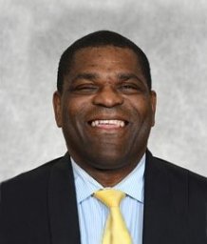
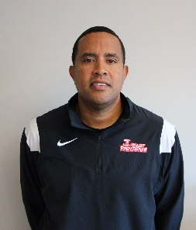
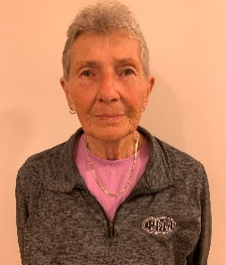





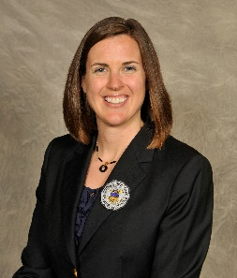



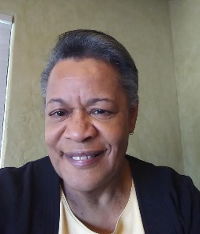
NFHS Rules Committee
Emily Mason
Columbus, OH
Chair - 2028
Derryk Sellers
Robbinsville, NJ
Section 1 - 2026
Alex Butler
East Providence, RI
Section 1 - 2028
Donna Brady
York, PA
Section 2 - 2025
Rhonda Dreibelbis
Chapel Hill, NC
Section 3 - 2027
Jeremy Hernandez
Gainesville, FL
Section 3 - 2029
Stacey Lambert
Bloomington, IL
Section 4 - 2028
Jeff Stauss
Lincoln, NE
Section 5 - 2028
Miranda Mizera
Maryville, MO
Section 5 - 2027
Bethany Brookens
Aurora, CO
Section 6 - 2027
Jan Whittaker
Midvale, UT
Section 7 - 2026
Kip Ryan
Helena, MT
Section 8 - 2029
Matt Seidl
Appleton, WI
NFHS Coaches - 2028
Nora Carter
Albuquerque, NM
NFHS Officials - 2026
Notes:
The 2026 Volleyball Rules Committee is comprised of a chair, representatives from the NFHS Coaches Association and the NFHS Officials Association, and representatives from each of the eight NFHS sections.

Slide 7


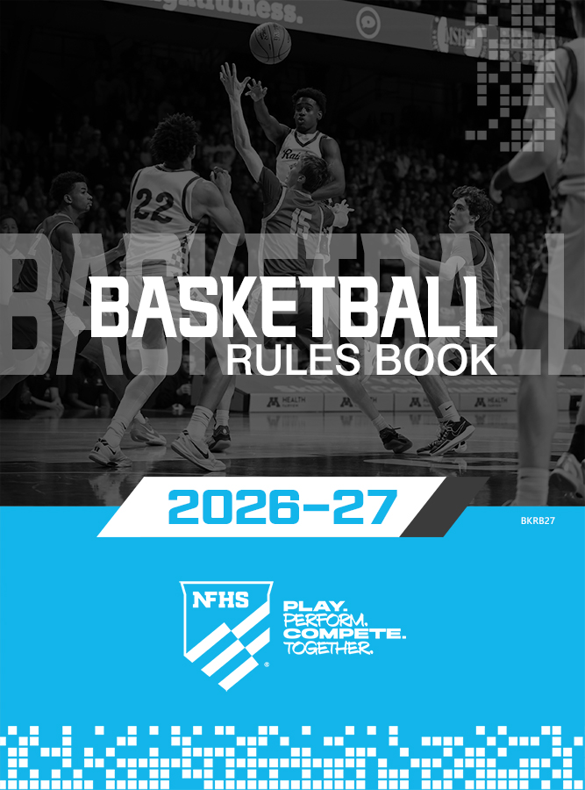




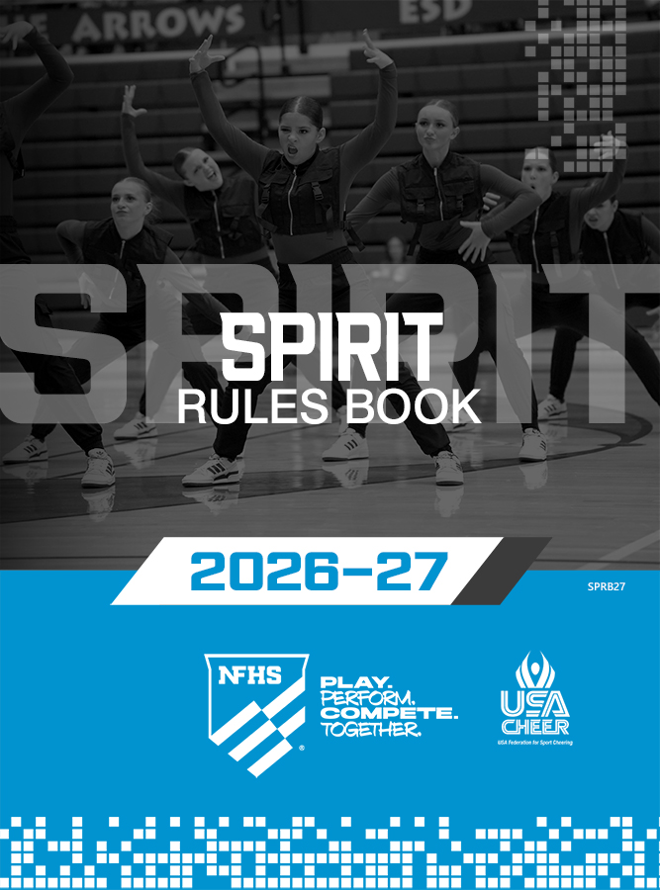










NFHS Publications
The NFHS writes playing rules for 18 sports
for boys and girls at the high school level.
  Publishes 2 million pieces of materials annually.
Notes:
The NFHS writes playing rules for 18 sports for boys and girls at the high school level.
Publishes 2 million pieces of materials annually.

Slide 8

NFHS Digital
NFHS Digital is the digital publications platform for the NFHS. The app includes:
  Rules Books
  Case Books
  Officials Manuals
  Preseason Guide
  Policy Debate Quarterly
  Other NFHS Publications

Slide 9

NFHS Digital – Mobile App
NFHS Digital is available via mobile app (on App Store or Google Play) or as a desktop platform.
Features include:
  View publications for sale in the NFHS Digital Store
  View publications assigned to/purchased by you
  Create comments, save notes, and share!
  Highlight content to review later
  Visit https://nfhs.org/about/nfhs-digital

Slide 10
2026 NFHS Volleyball
Rules Changes

Slide 11
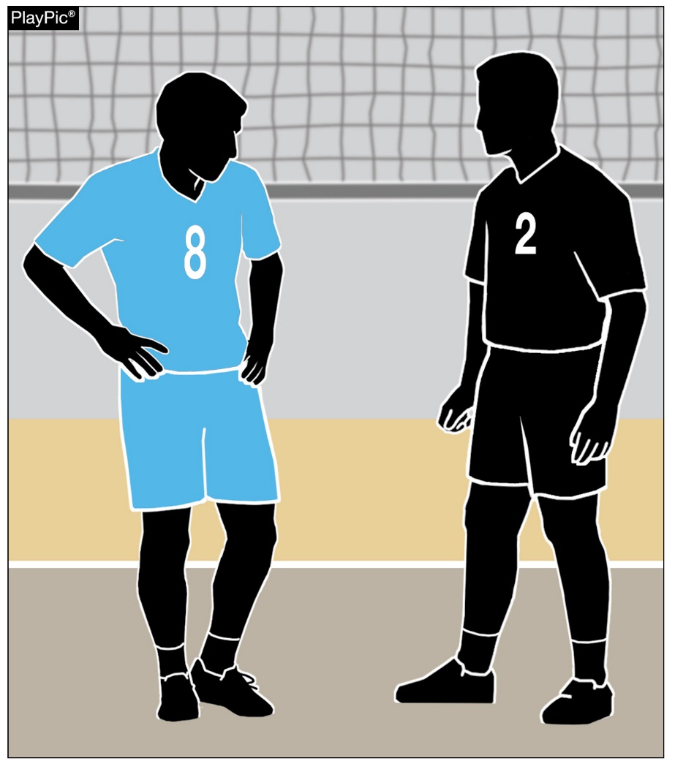
LEGAL UNIFORM
4-2-1a, 4-2-1i(3) (NEW), 4-2-2
Libero uniform bottoms may be any color and are no longer required to match the team uniform bottoms.
When two liberos are designated, there is no requirement that both liberos wear the same color uniform bottom.
Notes:
Libero uniform bottoms may be any color and are no longer required to match the team uniform bottoms.
When two liberos are designated, there is no requirement that both liberos wear the same color uniform bottom.
Rationale: Allows more flexibility in the libero uniform bottoms while ensuring that the libero uniform top continues to contrast with their teammates.

Slide 12
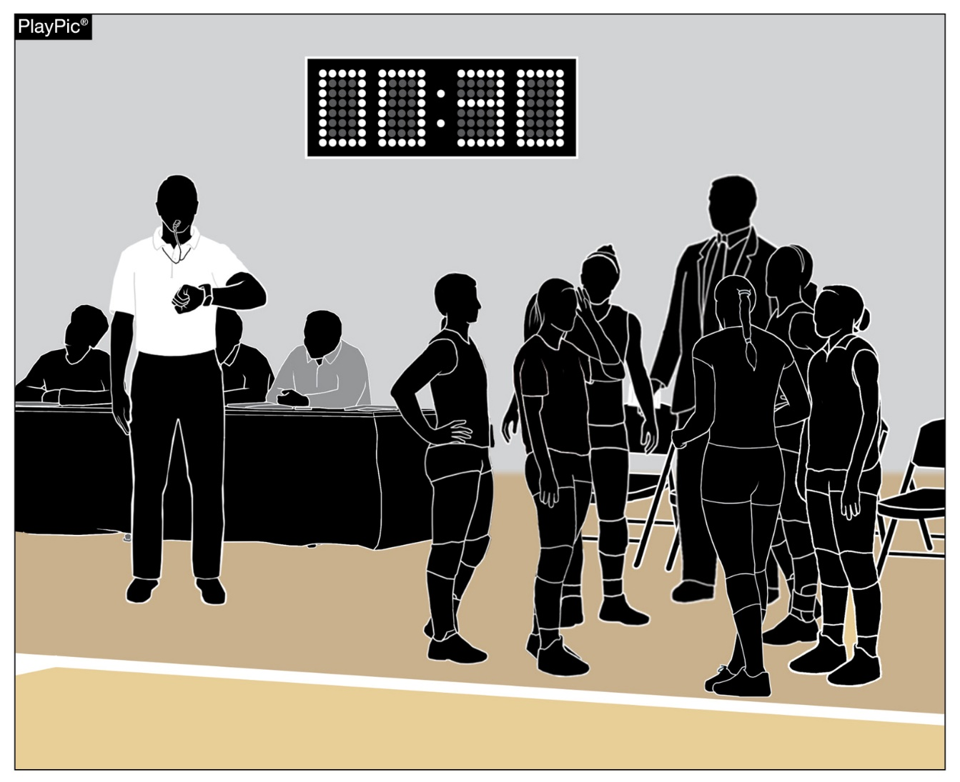
SECOND REFEREE RESPONSIBILITIES
5-5-3b(21)
Between sets, the second referee will provide a double whistle warning at two minutes, 30 seconds (4:30 when intermission is used) instead of 2 minutes, 45 seconds.
Notes:
Between sets, the second referee will provide a double whistle warning at two minutes, 30 seconds (4:30 when intermission is used) instead of 2 minutes, 45 seconds.
Rationale: Improves pace of play between sets by notifying teams earlier to make their way onto the court for the officials to administer lineup checks before the final audio signal and resumption of play.

Slide 13
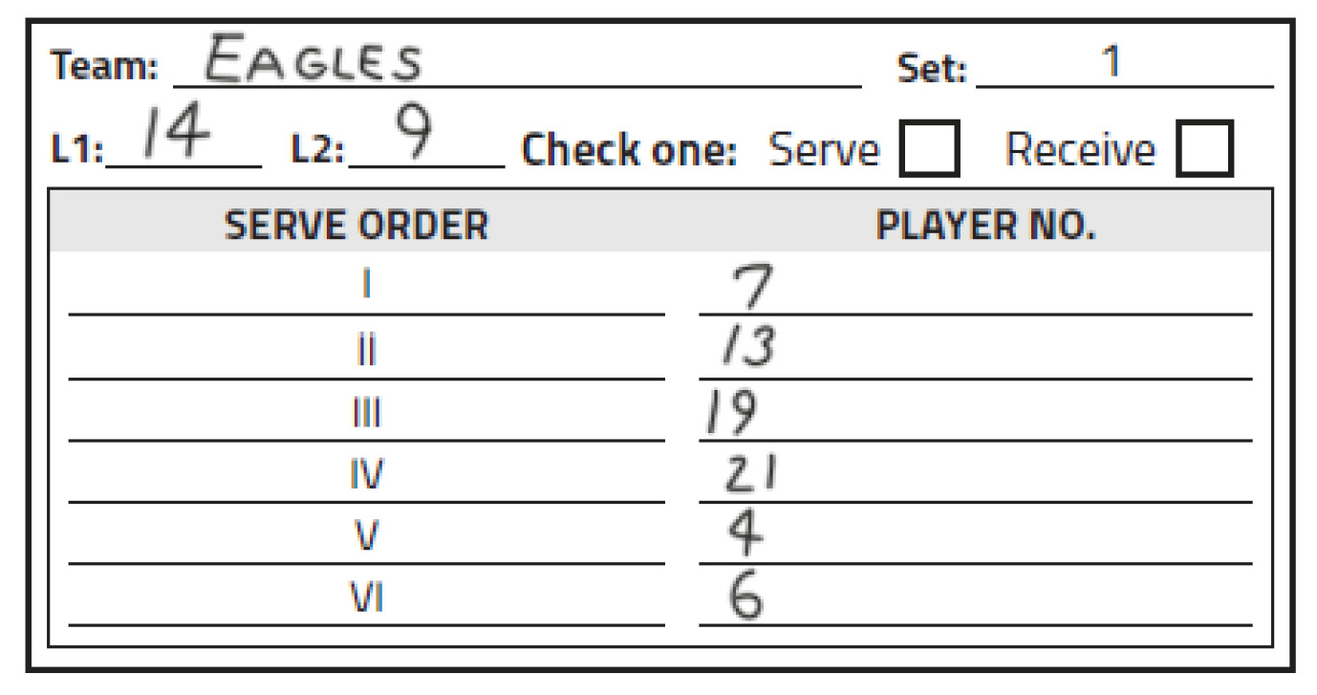
PLAYER POSITIONS
5-7-3c, 5-7-3d, 6-4-2, 8-1-6, 9-8-2, 10-3-6c, 10-4, 11-4-1b
A team may designate up to two liberos, but only one libero can be in the game at a time.
When two liberos are designated, either libero may serve in one position in the serve order. If the L1 and L2 serve, they must serve in the same position throughout the set.
Notes:
A team may designate up to two liberos, but only one libero can be in the game at a time.
When two liberos are designated, either libero may serve in one position in the serve order. If the L1 and L2 serve, they must serve in the same position throughout the set.

Slide 14
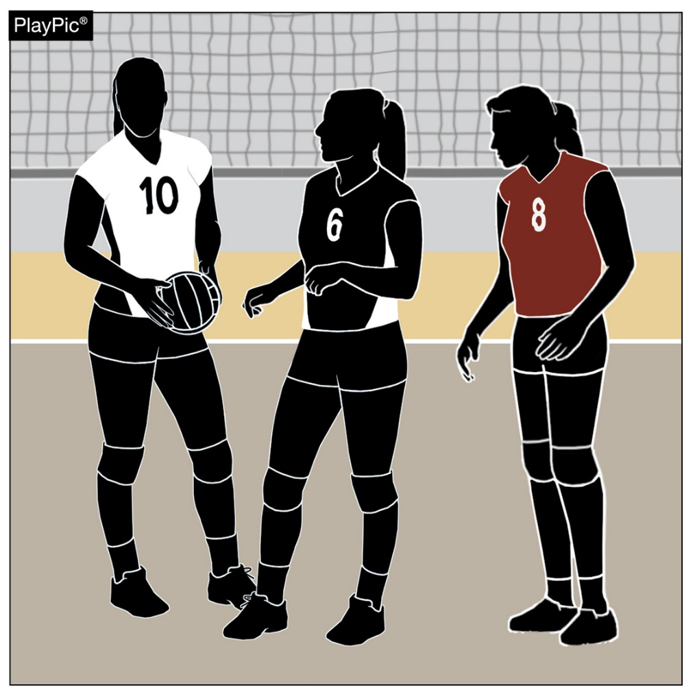
PLAYER POSITIONS
5-7-3c, 5-7-3d, 6-4-2, 8-1-6, 9-8-2, 10-3-6c, 10-4, 11-4-1b
Each libero may wear a different uniform, as long as that uniform clearly contrasts from non-libero teammates.
A libero may not wear a number that a non-libero teammate is wearing, and each libero uniform must be a different, unique number.
Notes:
Each libero may wear a different uniform, as long as that uniform clearly contrasts from non-libero teammates.
A libero may not wear a number that a non-libero teammate is wearing, and each libero uniform must be a different, unique number.

Slide 15
PLAYER POSITIONS
5-7-3c, 5-7-3d, 6-4-2, 8-1-6, 9-8-2, 10-3-6c, 10-4, 11-4-1b
When a team designates two liberos and one is injured/ill, a new libero may be re-designated.
When a team designates two liberos and one is disqualified; the team must continue with one libero.
Notes:
When a team designates two liberos and one is injured/ill, a new libero may be re-designated.
When a team designates two liberos and one is disqualified; the team must continue with one libero.
Rationale: The change to allow for up to two liberos, provides more student-athletes with an opportunity to participate by creating an option for coaches without having to utilize a substitution.

Slide 16
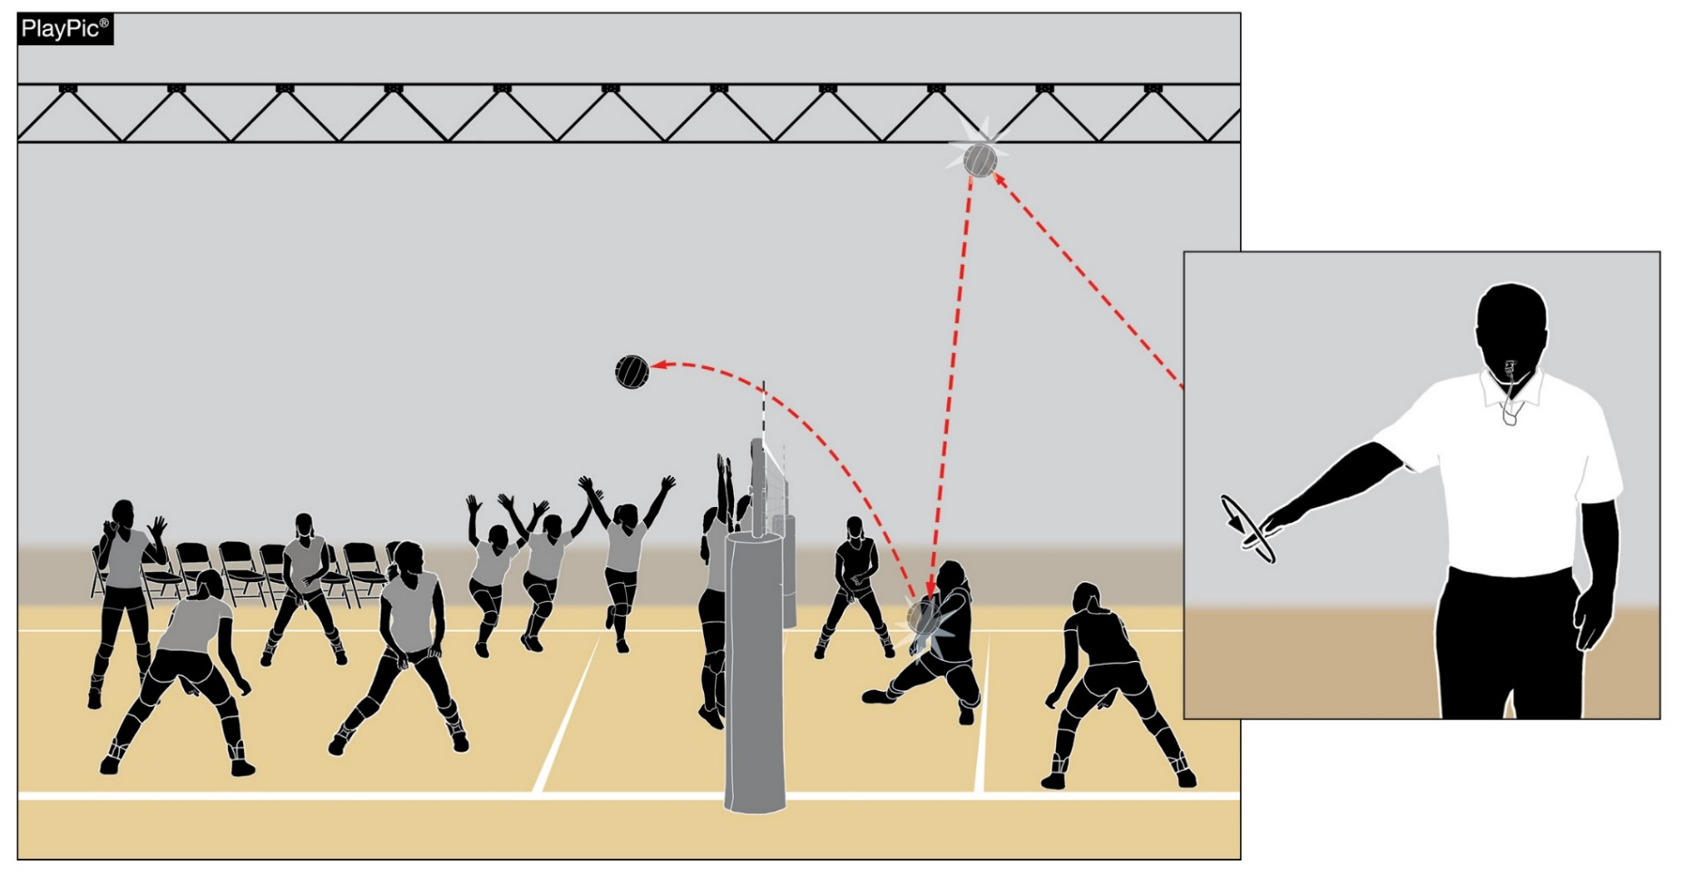
PLAYER POSITIONS
6-4 PENALTIES 1c (NEW), 12-2-8b NOTE (NEW)
If non-playing teammate(s) (bench players) enter the court during play, it is illegal alignment.
A loss of rally/point is awarded to the opponent.
Notes:
If non-playing teammate(s) (bench players) enter the court during play, it is illegal alignment.
A loss of rally/point is awarded to the opponent.
Rationale: More appropriately assesses illegal alignment (loss of rally/point awarded to the opponent) to non-playing teammates who enter the court while the ball is in play. A player who enters the court during play may still receive a conduct violation if they engage in disconcerting acts, disrespectful language, etc. This penalty realignment allows officials to appropriately penalize teams based on participant actions.

Slide 17
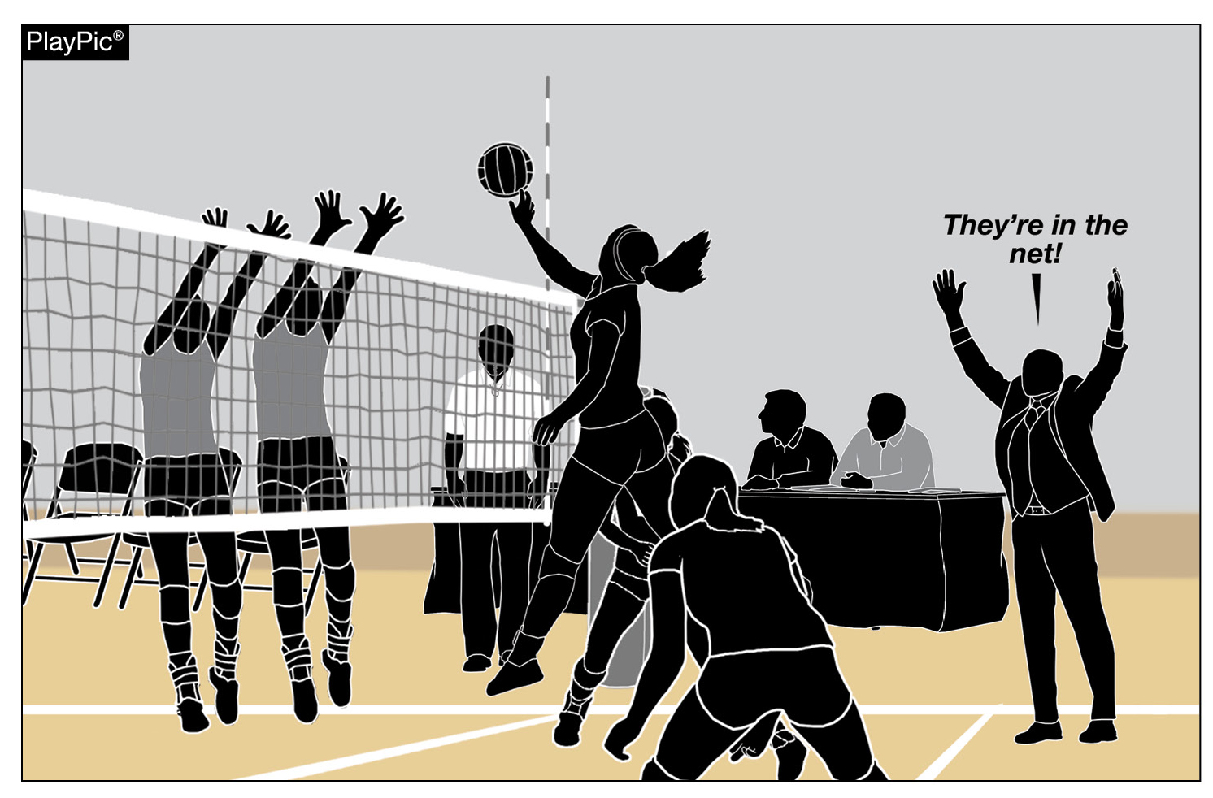
PLAYER POSITIONS
6-4 PENALTIES 1c (NEW), 12-2-8b NOTE (NEW)
It remains a conduct violation if a coach or team attendant (anyone not in uniform) enters the court while the ball is in play.
Notes:
It remains a conduct violation if a coach or team attendant (anyone not in uniform) enters the court while the ball is in play.

Slide 18
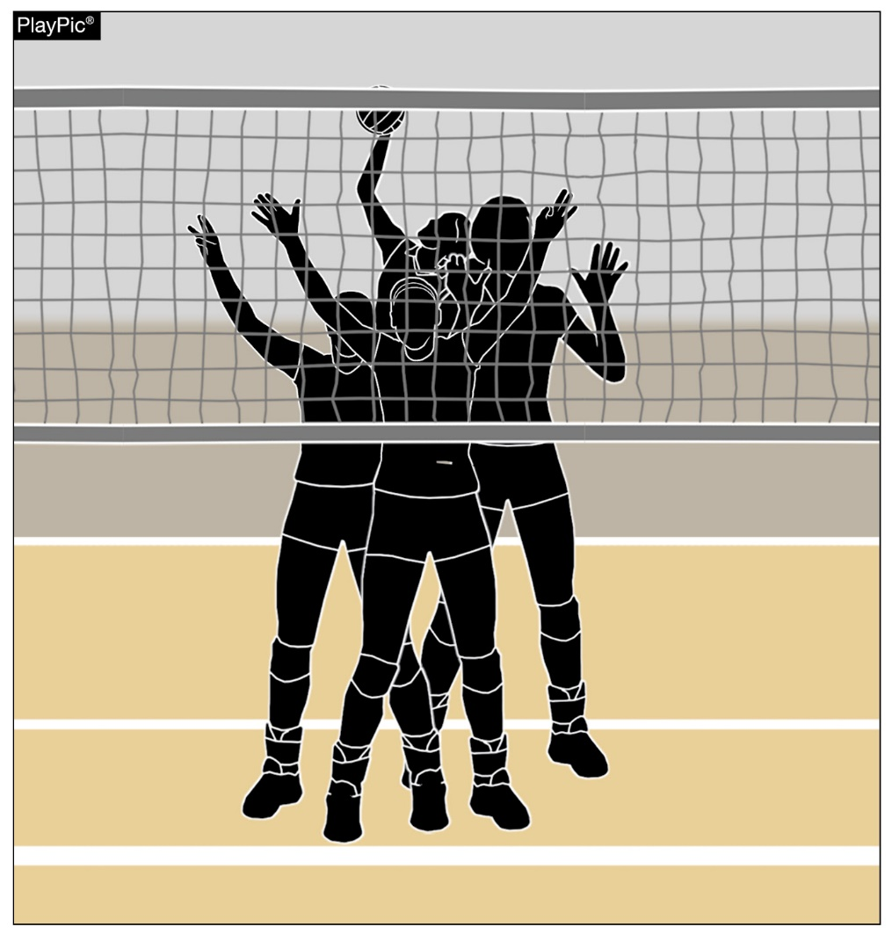
SCREENING
6-5-1
Players on the serving team are not permitted to raise their hands above their heads during service until the ball has passed beyond the net.
Players may quickly raise their hands above their heads to give hand signals and then lower their arms immediately.
Players may also stand with their hands locked together behind their heads to protect the back of their heads during service.
Notes:
Players on the serving team are not permitted to raise their hands above their heads during service until the ball has passed beyond the net.
Players may quickly raise their hands above their heads to give hand signals and then lower their arms immediately.
Players may also stand with their hands locked together behind their heads to protect the back of their heads during service.
Rationale: Discourages player positioning during the serve that prevents the receiving team from viewing service contact and/or the flight of the ball and assists officials when evaluating the existence of screening. This change aligns with all other volleyball rules codes.

Slide 19
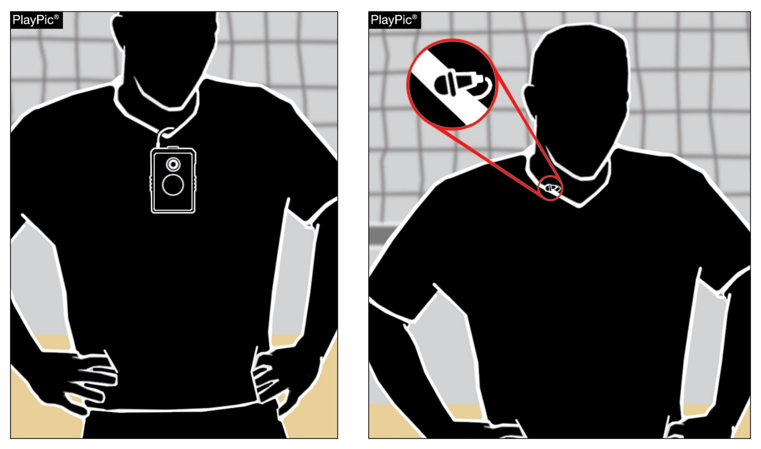
COURT PROTOCOL
9-2-1 NOTE 1 (NEW)
Players shall not wear any audio or video devices during the match.
If referees notice devices on players prior to the match, they should notify the coach to direct the player to remove the device.
If discovered during play, the player should be assessed an unsporting conduct penalty.
Notes:
Players shall not wear any audio or video devices during the match.
If referees notice devices on players prior to the match, they should notify the coach to direct the player to remove the device.
If discovered during play, the player should be assessed an unsporting conduct penalty.
Rationale: Clarifies the prohibition of electronic communication with and by players during the match and aligns with other NFHS rules codes.

Slide 20
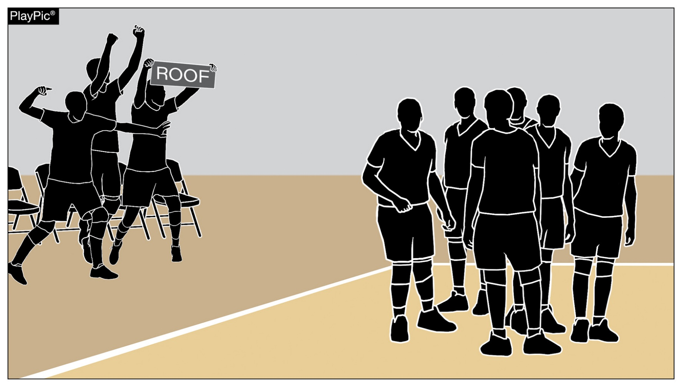
CONDUCT: PLAYERS, COACHES AND/OR TEAM ATTENDENT
12-2-8m (NEW)
It is an unsporting conduct violation if coaches, non-playing teammates or team attendants use props on the bench during celebrations.
Notes:
It is an unsporting conduct violation if coaches, non-playing teammates or team attendants use props on the bench during celebrations.
Rationale: Clarifies appropriate bench conduct for consistent enforcement by eliminating the use of props in bench celebrations while promoting sportsmanship and preventing disruption and potential safety concerns.

Slide 21
Rules Reminders

Slide 22
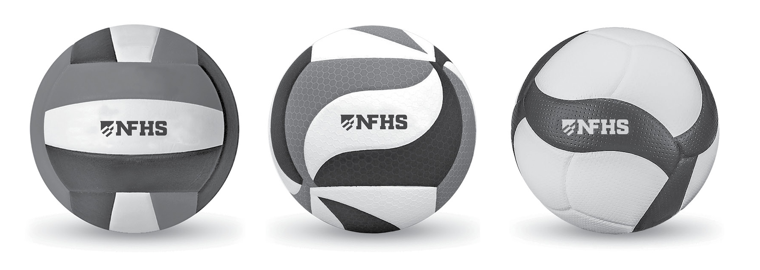
THE BALL
3-2-1 NOTE
Beginning with the 2026-27 school year, state associations may adopt the use of a non-smooth or textured volleyball. There are no restrictions on color or shape of panels for textured volleyballs.
Notes:
Beginning with the 2026-27 school year, state associations may adopt the use of a non-smooth or textured volleyball. There are no restrictions on color or shape of panels for textured volleyballs.
Rationale: Allows either boys or girls to adopt a textured volleyball with no restrictions on color or shape of panels to be inclusive of all current textured volleyballs on the market.

Slide 23
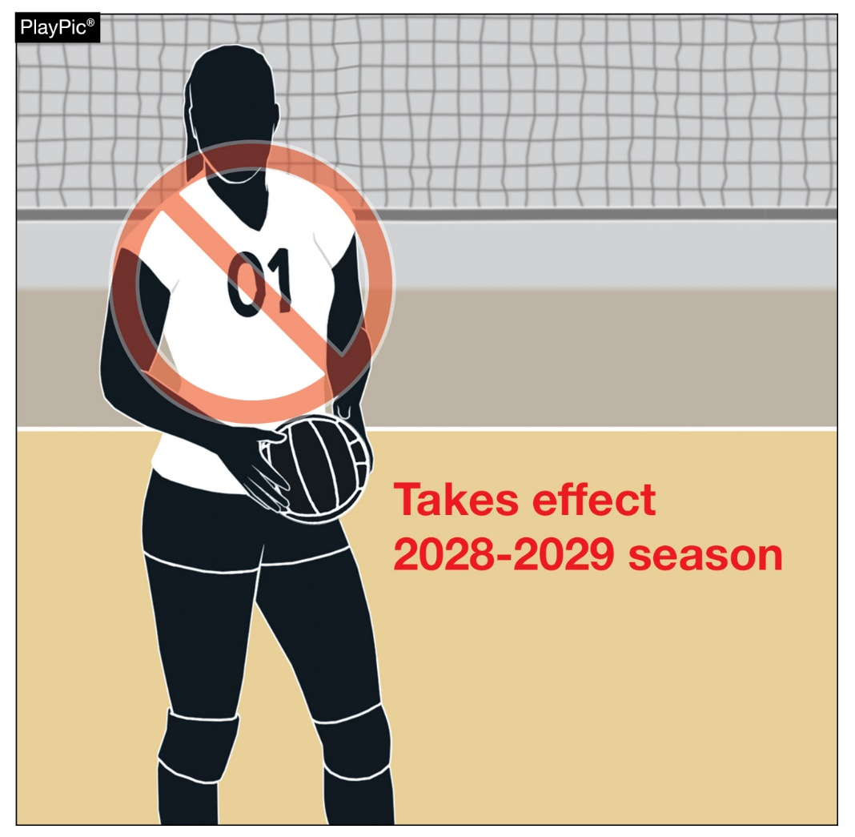
LEGAL UNIFORM
4-2-4b
Numbers with a leading zero (01, 02, 03, etc.) will be non-compliant beginning in 2028. Legal uniforms must be numbered 0-99.
The use of the number double zero (00) on uniforms is illegal.
Notes:
Numbers with a leading zero (01, 02, 03, etc.) will be non-compliant beginning in 2028. Legal uniforms must be numbered 0-99.
The use of the number double zero (00) on uniforms is illegal.
Rationale: Clarifies legal numbers and eliminates confusion when signaling while aligning with other rules codes.

Slide 24
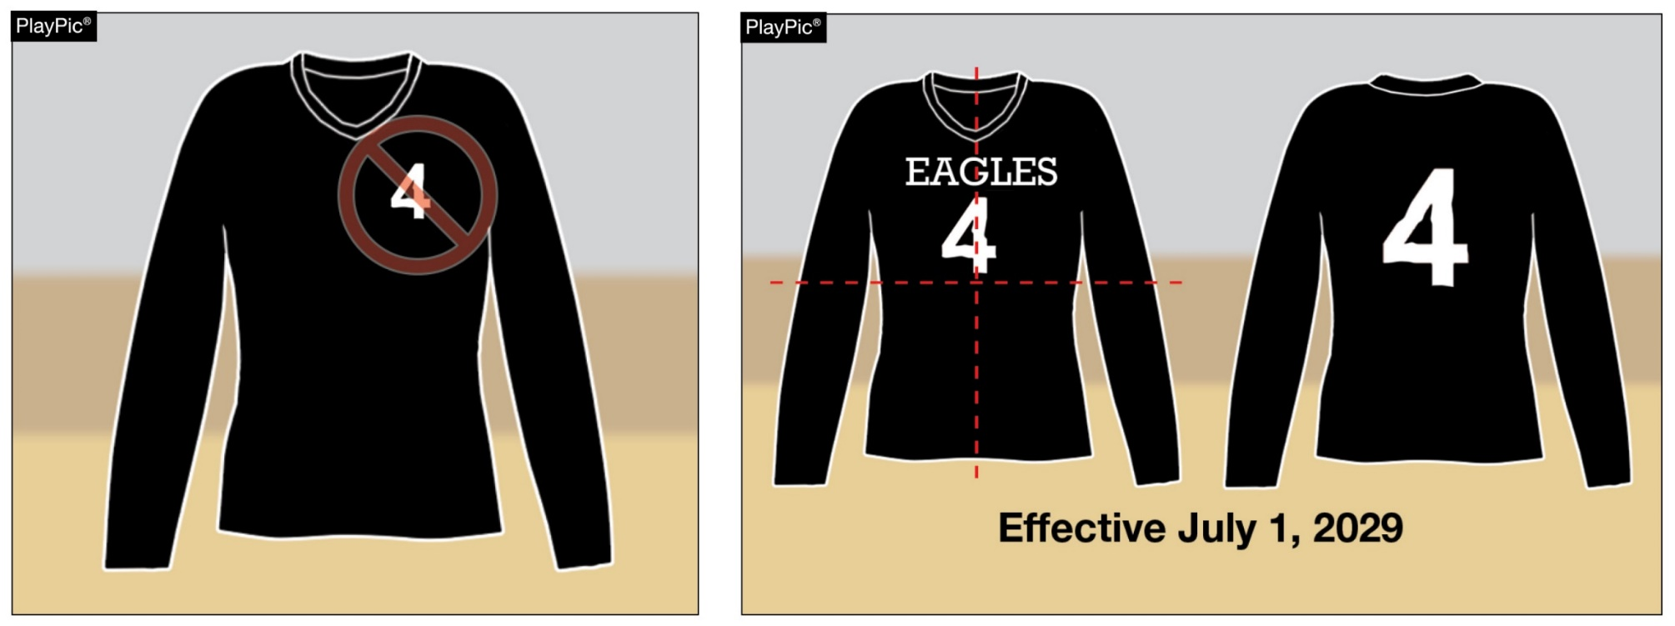
LEGAL UNIFORM
4-2-4d, f
Beginning July 1, 2029, the number on the front of the uniform must be centered on the upper half of the uniform top, eliminating the measurement requirements from the shoulder seam to the neckline.
Notes:
Beginning July 1, 2029, the number on the front of the uniform must be centered on the upper half of the uniform top, eliminating the measurement requirements from the shoulder seam to the neckline.
Rationale: Removes officials from the position of measuring uniforms to verify the legal distance of the number from the shoulder or neckline, creates consistency in number placement, and allows for number placement variances due to player body types.

Slide 25
2026 NFHS Editorial Changes

Slide 26
Editorial Changes
1-5-1 – Added language within Section 5: Termination of Set/Match from 5-4-4d stating that the match becomes official and there shall be no change of score after the scoresheet is initialed by the second referee.
5-2-1b – Clarified current language when a fault is whistled by the second referee.
5-4-3c(1) – Clarified procedural language now that entire teams are allowed to stand on the end line during the prematch ceremony.
5-4-4a – Rewritten for clarity.
Notes:
1-5-1 – Added language within Section 5: Termination of Set/Match from 5-4-4d stating that the match becomes official and there shall be no change of score after the scoresheet is initialed by the second referee.
5-2-1b – Clarified current language when a fault is whistled by the second referee.
5-4-3c(1) – Clarified procedural language now that entire teams are allowed to stand on the end line during the prematch ceremony.
5-4-4a – Rewritten for clarity.

Slide 27
Editorial Changes
7-1-1a, 7-1-1 PENALTIES 3, 7-1-2a, 7-1-4 PENALTIES – Rewritten for clarity.
9-9-1h – Corrected language due to 2025-26 rule change for an illegal replacement attempting to enter the set.
12-2-8 – Replaced “substitutes” with “non-playing teammates” to more appropriately describe teammates who are on the bench.
Notes:
7-1-1a, 7-1-1 PENALTIES 3, 7-1-2a, 7-1-4 PENALTIES – Rewritten for clarity.
9-9-1h – Corrected language due to 2025-26 rule change for an illegal replacement attempting to enter the set.
12-2-8 – Replaced “substitutes” with “non-playing teammates” to more appropriately describe teammates who are on the bench.

Slide 28
2026 NFHS Volleyball
Points of Emphasis

Slide 29
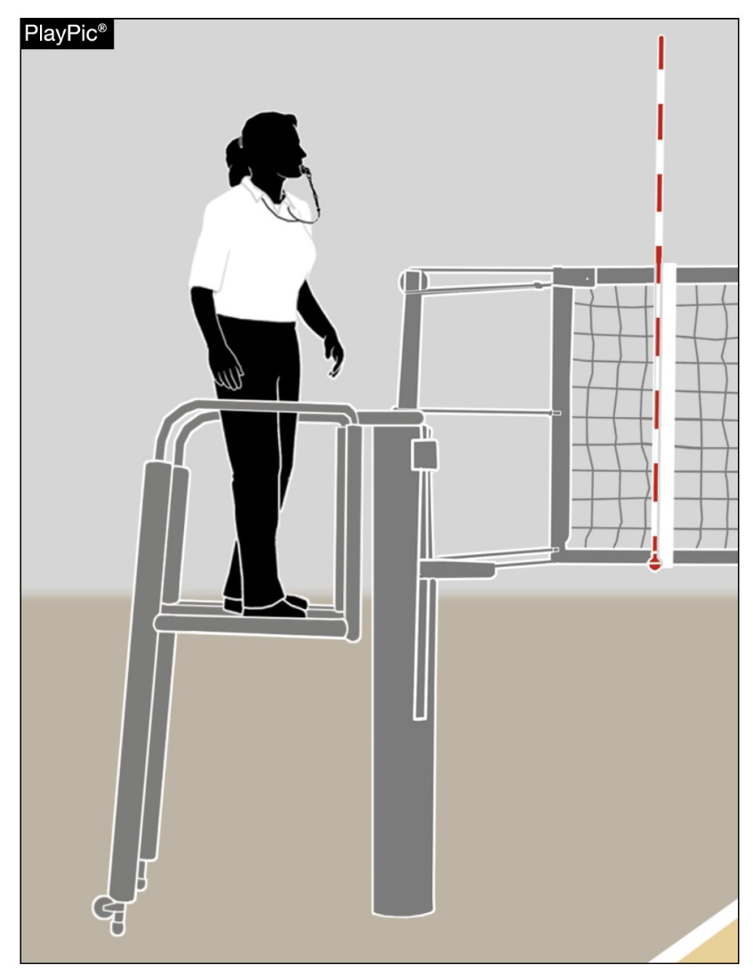
HOST MANAGEMENT BEST PRACTICES
By rule, hosts must provide a safe, stable platform. The first referee (R1) should carefully examine the stand prior to the match, and if the R1 determines that the platform is unsafe, the match will still go on, and the R1 will work from the floor.
Referees should not use ladders, chairs, boxes, trash cans or similar substitutes that could endanger the well-being of the official.
Notes:
By rule, hosts must provide a safe, stable platform. The first referee (R1) should carefully examine the stand prior to the match, and if the R1 determines that the platform is unsafe, the match will still go on, and the R1 will work from the floor.
Referees should not use ladders, chairs, boxes, trash cans or similar substitutes that could endanger the well-being of the official.

Slide 30
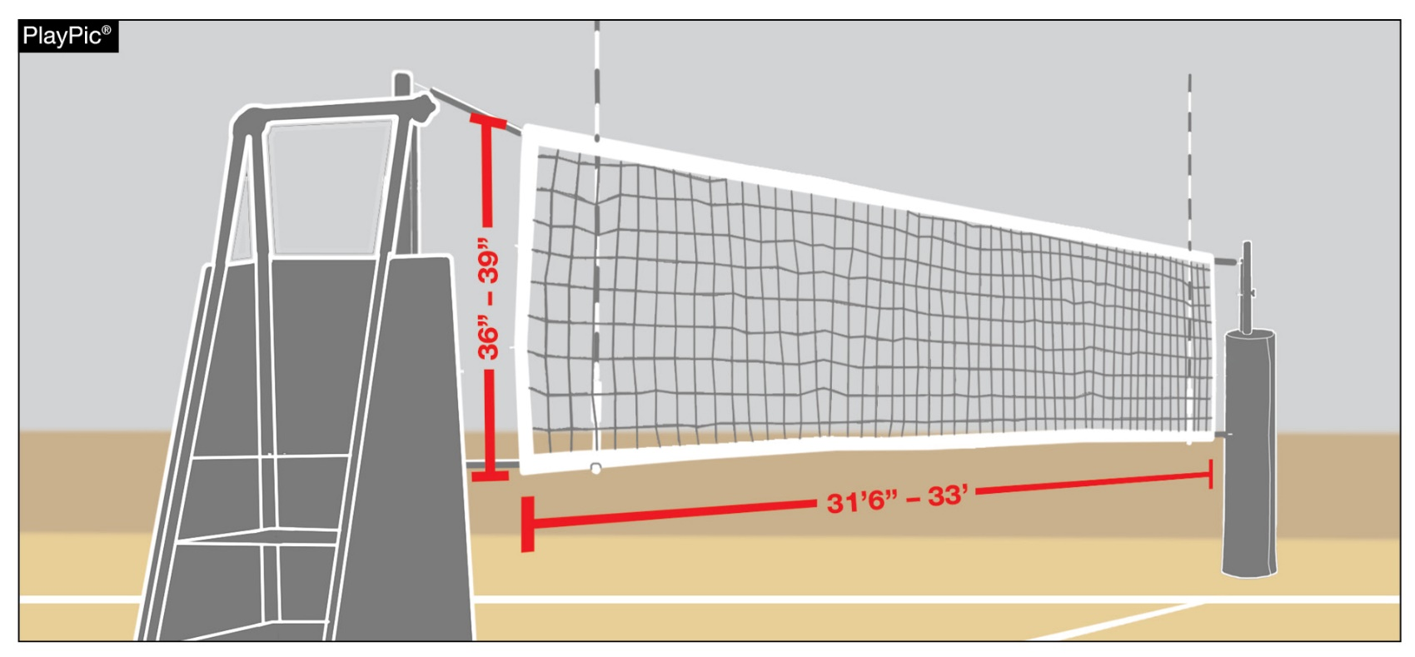
HOST MANAGEMENT BEST PRACTICES
Regularly evaluate volleyball equipment for signs of wear like frayed nets or cables, posts that are bending inwards, and padding that no longer protects or fits tightly — plus any parts that no longer hold proper tension. Any time you see a post or net that has been taped or improvised to keep it working, it is a sign the system is not performing — or protecting athletes and officials — the way it was designed to and should be replaced.
Notes:
Regularly evaluate volleyball equipment for signs of wear like frayed nets or cables, posts that are bending inwards, and padding that no longer protects or fits tightly — plus any parts that no longer hold proper tension. Any time you see a post or net that has been taped or improvised to keep it working, it is a sign the system is not performing — or protecting athletes and officials — the way it was designed to and should be replaced.

Slide 31
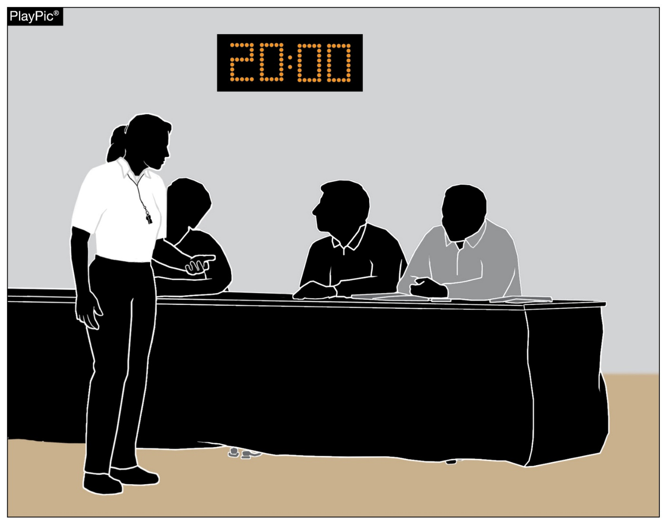
HOST MANAGEMENT BEST PRACTICES
To set the match up for success, it is imperative that assistant officials (scorer, libero tracker, timer and line judges) are secured by host management and have reported to the first referee no less than 20 minutes prior to the starting time.
Notes:
To set the match up for success, it is imperative that assistant officials (scorer, libero tracker, timer and line judges) are secured by host management and have reported to the first referee no less than 20 minutes prior to the starting time.

Slide 32
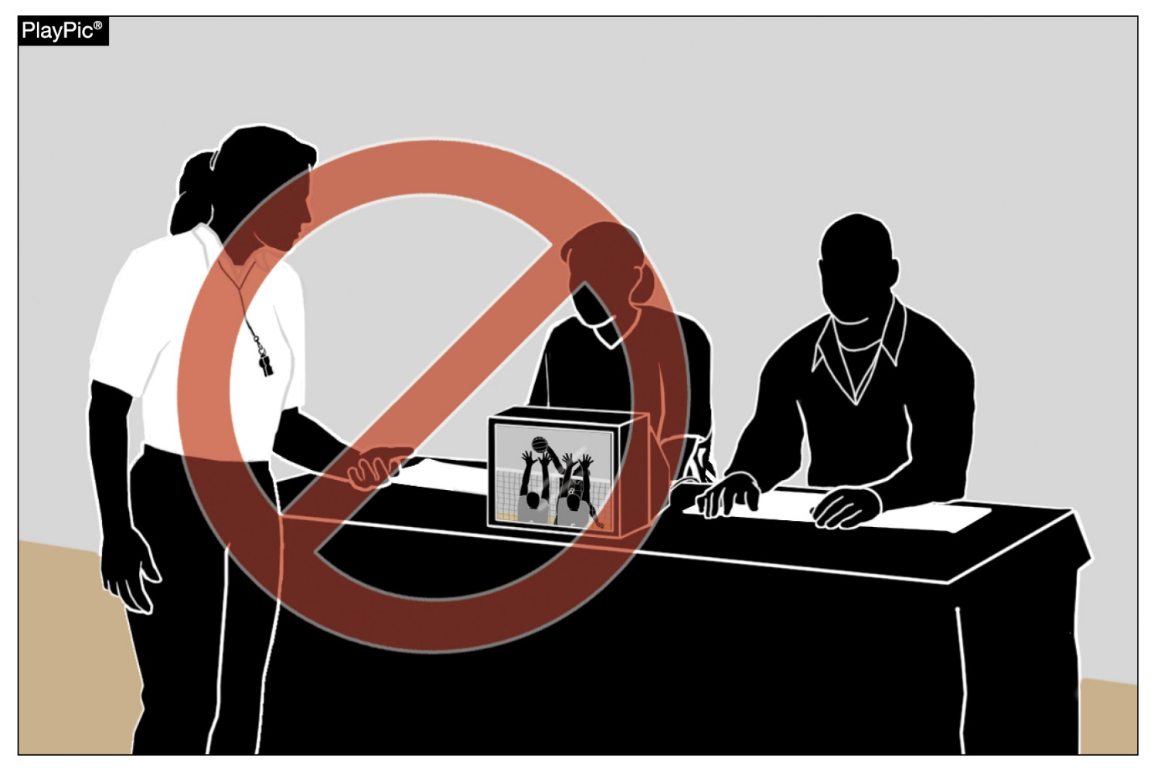
ELECTRONIC DEVICES
At no time during the match may an official use an electronic device to review a decision of the referee.
At no time shall the first or second referee consider replay.
Notes:
At no time during the match may an official use an electronic device to review a decision of the referee.
At no time shall the first or second referee consider replay.

Slide 33
Electronic Devices
A team may use electronic devices during the match as long as they are not in restricted areas as determined by the host and as long as the first referee determines that they are not interfering with the contest.
Referees are permitted to wear headsets for communication purposes. Officiating Volleyball: Using Wireless Communication
State associations may have policies to further address the allowance and/or restriction of electronic device use during matches.
Notes:
A team may use electronic devices during the match as long as they are not in restricted areas as determined by the host and as long as the first referee determines that they are not interfering with the contest.
Referees are permitted to wear headsets for communication purposes. Officiating Volleyball: Using Wireless Communication
State associations may have policies to further address the allowance and/or restriction of electronic device use during matches.

Slide 34

BENCH PERSONNEL – NON-PLAYING TEAMMATES
Non-playing teammates (bench players) and other bench personnel have a role to positively support their teammates by celebrating and encouraging those playing on the court with spontaneous cheers.
It is not legal for anyone on the bench to use props.
A towel is athletic equipment and is not considered a prop if used in conjunction with a spontaneous celebration.
Notes:
Non-playing teammates (bench players) and other bench personnel have a role to positively support their teammates by celebrating and encouraging those playing on the court with spontaneous cheers.
It is not legal for anyone on the bench to use props.
A towel is athletic equipment and is not considered a prop if used in conjunction with a spontaneous celebration.

Slide 35
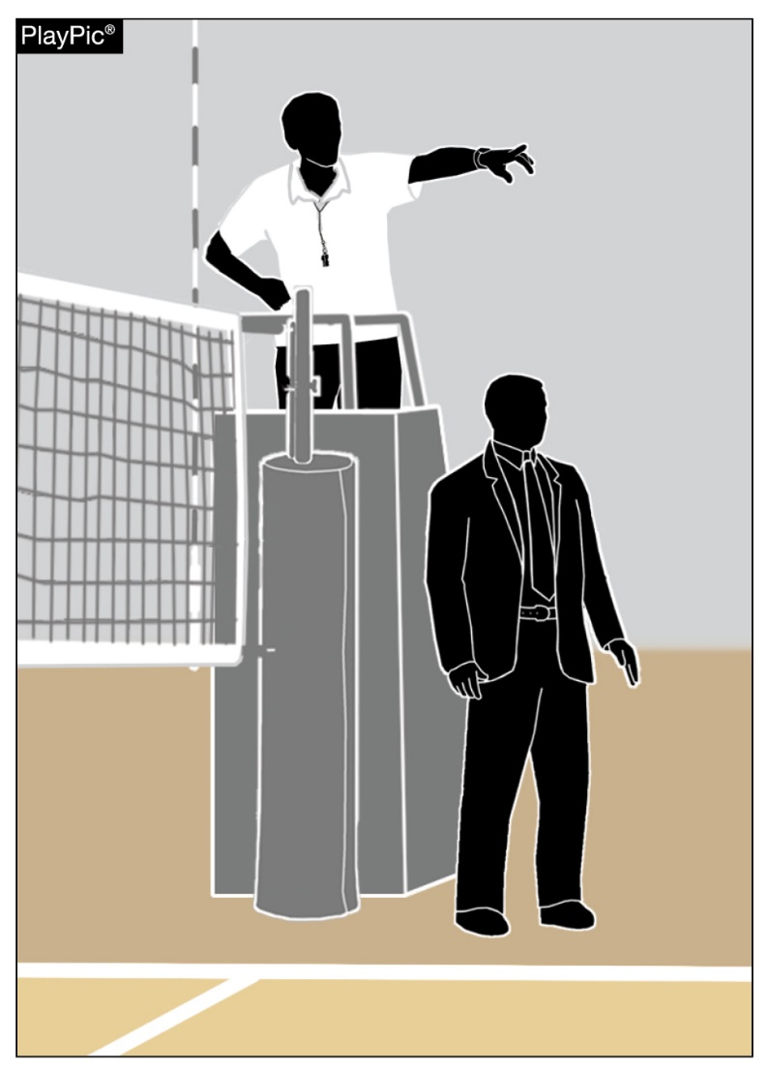
BENCH PERSONNEL – NON-PLAYING TEAMMATES
Game officials shall not address spectators at any time; however, referees have the responsibility to notify game management of any spectator misconduct.
Unsporting conduct by spectators is the responsibility of the host management. In the absence of host management, the responsibility for addressing spectator behavior shall revert to the host head coach.
Notes:
Game officials shall not address spectators at any time; however, referees have the responsibility to notify game management of any spectator misconduct.
Unsporting conduct by spectators is the responsibility of the host management. In the absence of host management, the responsibility for addressing spectator behavior shall revert to the host head coach.

Slide 36
IDENTIFICATION OF THE NFHS AUTHENTICATING MARK ON GAME BALLS
All game balls are required to display the NFHS Authenticating Mark.
Game officials must remain vigilant and report any non-compliant game balls to the state association office.
Notes:
All game balls are required to display the NFHS Authenticating Mark.
Game officials must remain vigilant and report any non-compliant game balls to the state association office.

Slide 37
NFHS Officials Education

Slide 38

All Things Officiating in One Place!
The all-in-one, cloud-based NFHS Center for Officials Services (COS) connects everyone associated with officiating. The COS handles registration, assignments, testing, payments, and a host of other features and integrations that consolidate all officiating needs into a single, modern solution. Free to all NFHS state associations, local associations, and assigner groups.
20+
Member States
300,000+
Officials
7,000+
Schools

Slide 39
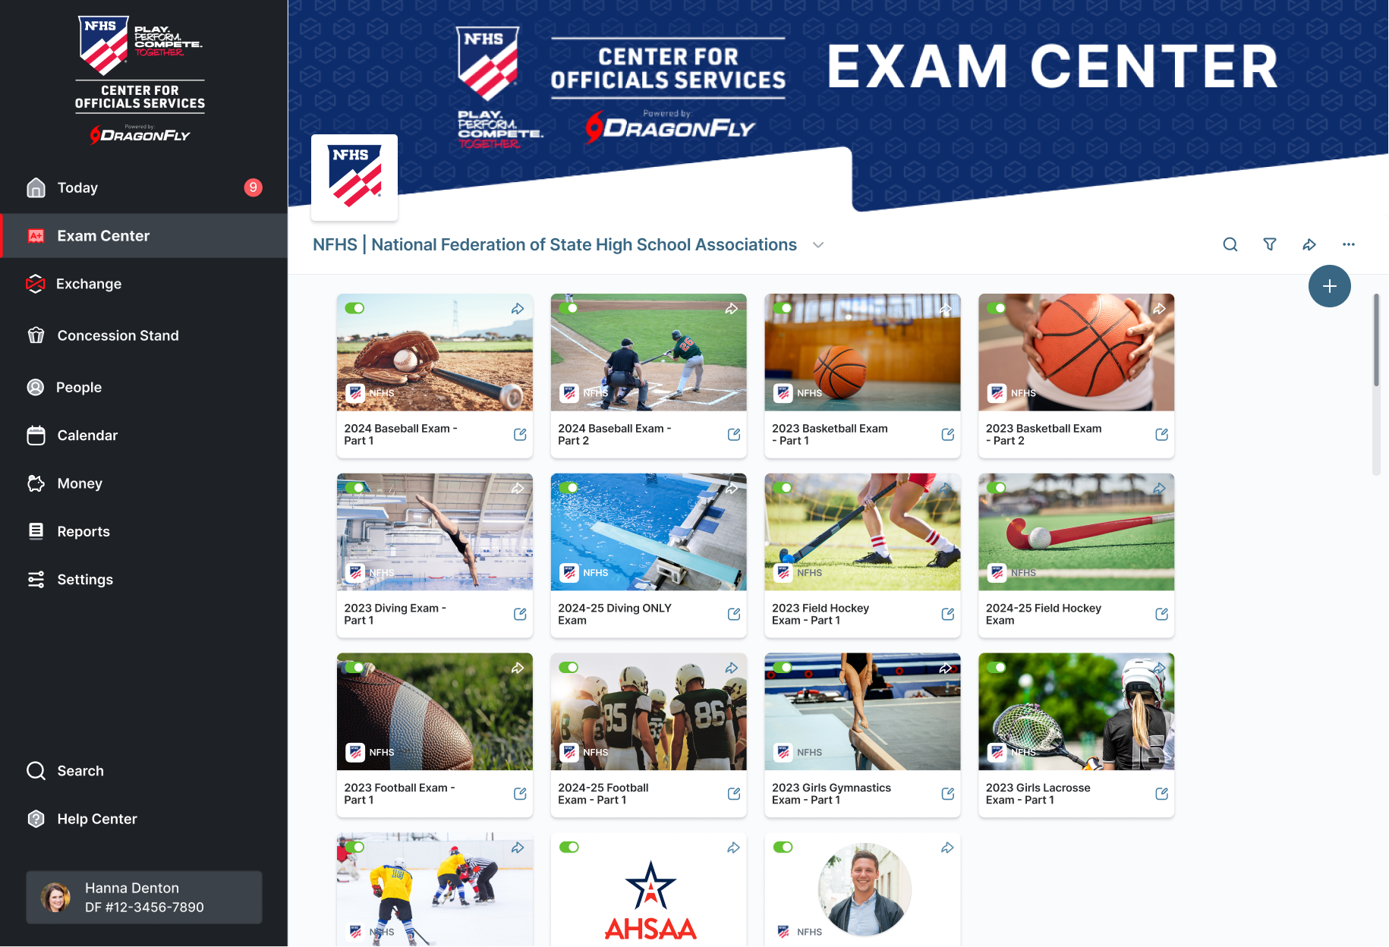
Improved Exam Center

Slide 40
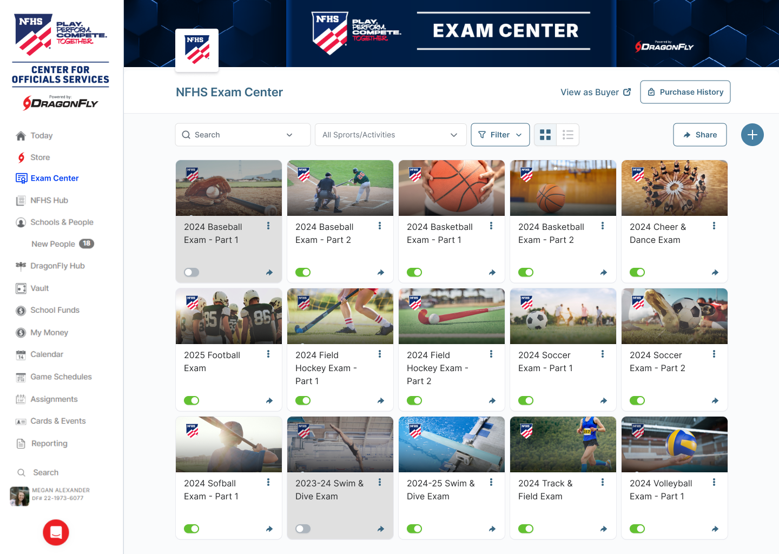

Slide 41
NFHS Learning Center

Slide 42

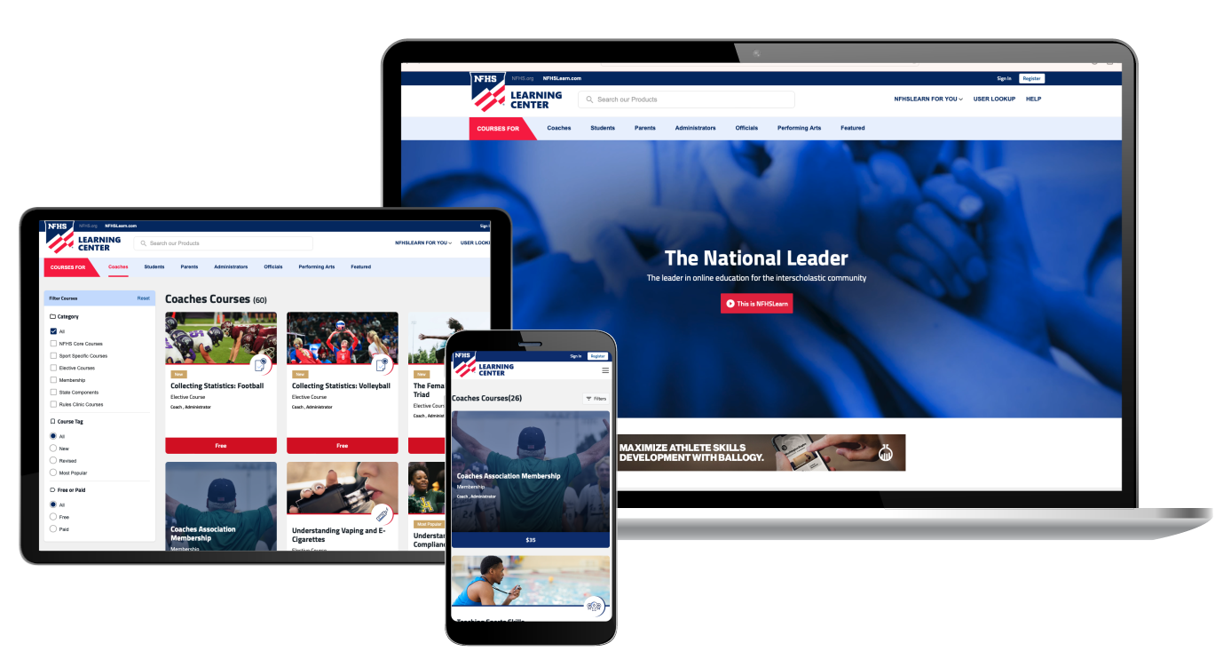
The National Leader
100+ Online Courses
75+ Available at No Cost!
Active in All 50 States
Valuable Professional Development
Earn Completion Certificates
Earn National Credentials
Earn Badges
www.nfhslearn.com

Slide 43
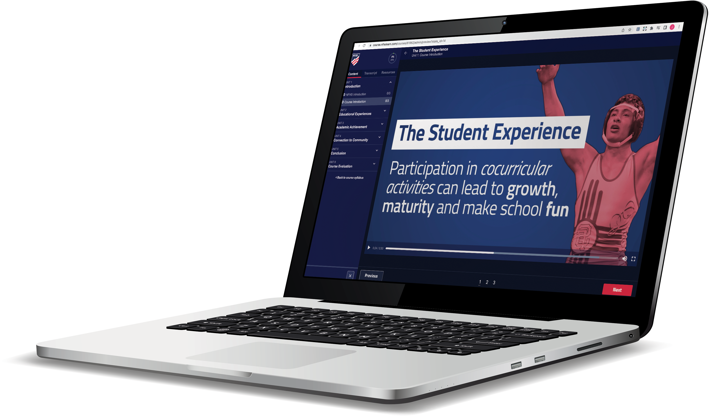
Over 29 million courses delivered!
Concussion in Sports – 9.2M+
Heat Illness Prevention – 3.6M+
Sudden Cardiac Arrest – 3.9M+
Concussion for Students – 2.1M+
The Collapsed Student (2020) – 108,000+
CPR & AED Training (2023) – 55,500+
Sportsmanship – 1.7M+
Fundamentals of Coaching – 1.1M+
First Aid, Health and Safety – 505,000+
Bullying, Hazing and Inappropriate Behaviors – 658,000+
Student Mental Health and Suicide Prevention – 460,000+
Coaching Mental Wellness (2025) – 37,750+
Emergency Action Planning for Afterschool Programs (2025) – 14,600+

Slide 44

NFHS Network

Slide 45
NFHS Network
27 Different Sports and Activities.
By 2028, every high school event
in America will be streamed live.
The NFHS Network will be
THE DESTINATION for fans.
OUR NETWORK
www.NFHSnetwork.com

Slide 46

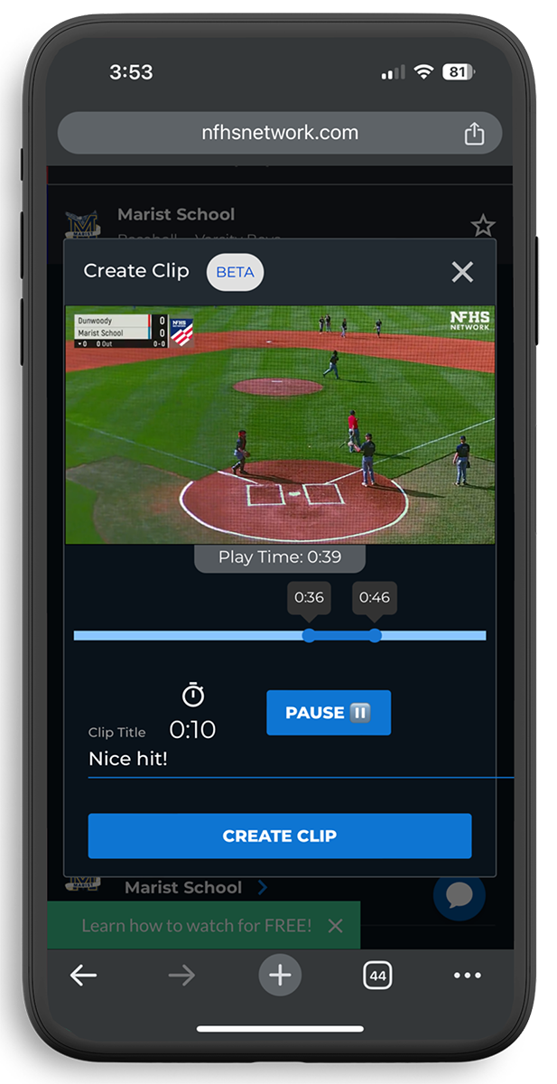
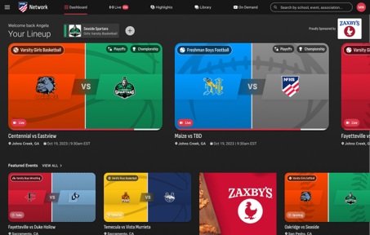
Capture Your Memories –
Clip and Share
Allowing fans to capture and share their favorite moments
Notes:
The NFHS Network will broadcast over 150,000 live events this year. If your school is not a member of the NFHS Network School Broadcast Program, please contact us at Mark.Koski@NFHSnetwork.com

Slide 47
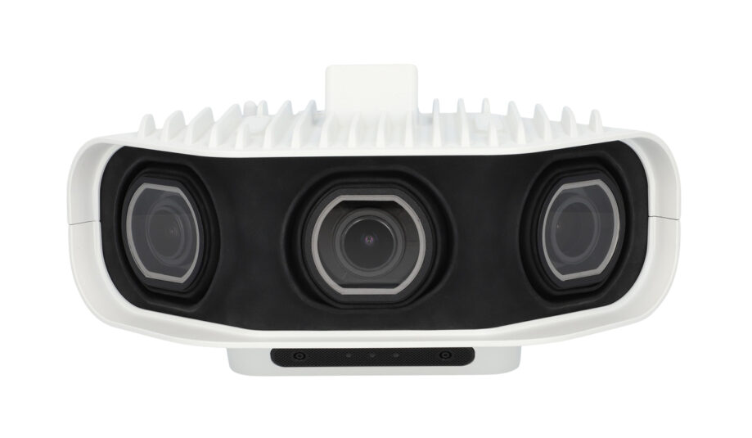


Automated Content Platform: Summary
Live Stream
+
VOD
VOD
Pixellot Camera
Coaching Platform
Game Breakdown
100%
Automated
Score, Team Stats,
Player Stats
Short Form Videos

Slide 48


Slide 49
NFHS Store

Slide 50
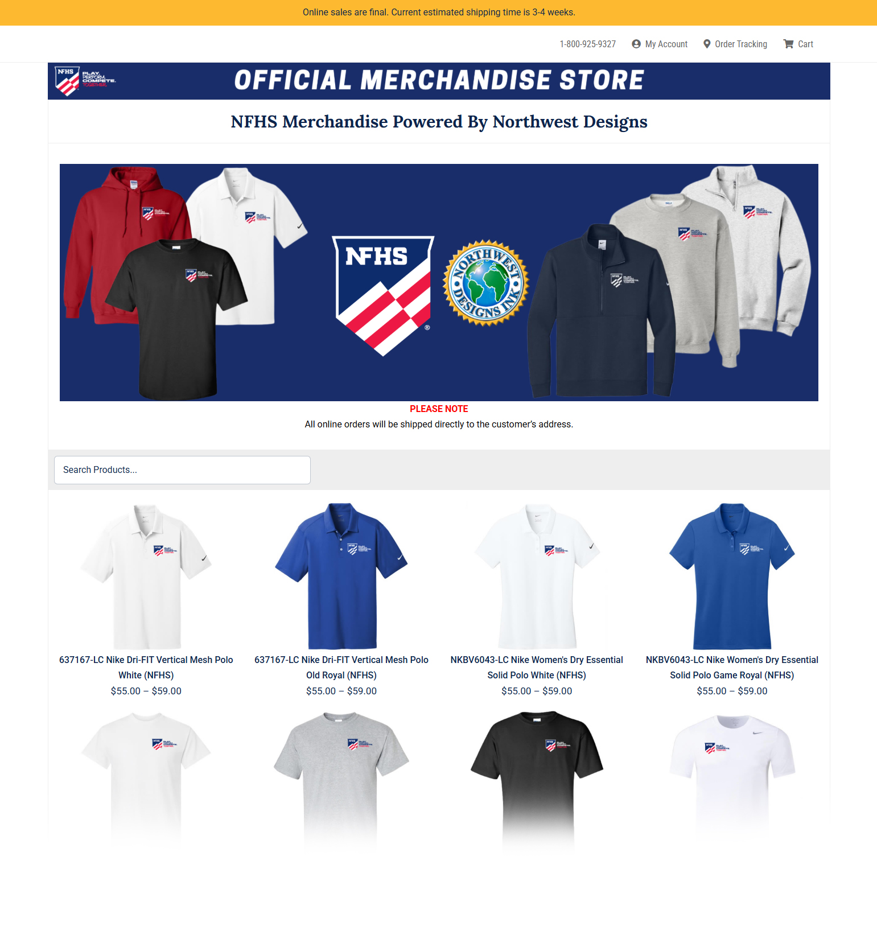
NFHS Store
We’re excited to introduce a new NFHS Store, powered by Northwest Designs, making it easier than ever to shop NFHS-branded apparel and have it delivered straight to your home or office. The collection features t-shirts, polos, sweatshirts, and quarter-zips from top brands like Nike and Gildan. We can’t wait to see our membership proudly representing the NFHS brand!
https://online-apparel.com/s/nfhs-merchandise/

Slide 51
NFHS Authentication Mark Update

Slide 52



NFHS Authenticating Mark Update
Specifications
Do not use the NFHS Authenticating Mark without prior written approval from the NFHS
This mark is for use of licensees only.
Minimum size
  Inflatable Balls - 2 ½“ in length (Basketball, Football, Soccer, Volleyball, and Water Polo)
  Non-Inflatable Balls - 1 ¼" in length (Baseball, Field Hockey, Ice Hockey Puck, Lacrosse, and Softball)
  On a ball or puck, the NFHS mark may be smaller than manufacturer’s logo, but should be placed in proximity to the manufacturer’s name for easy identification. Allow enough space around the mark so it can be easily recognized as distinct and separate.
  Reproduce the mark only from the vector artwork provided on Direct Licensing Hub. Do not copy, scan art electronically or use as a template to redraw the symbol.
Note: If sizing or specifications do not work well in your particular design situation, contactK12 Licensing.
Old Logos
Current Logo

Slide 53
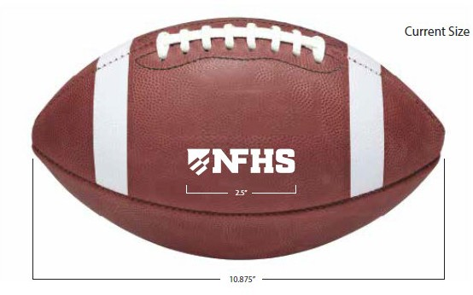
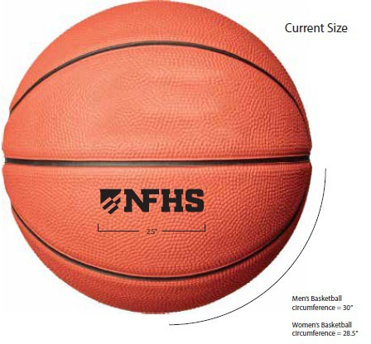
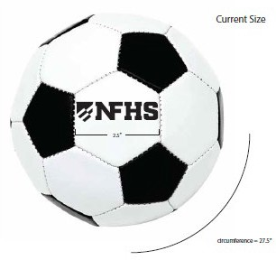
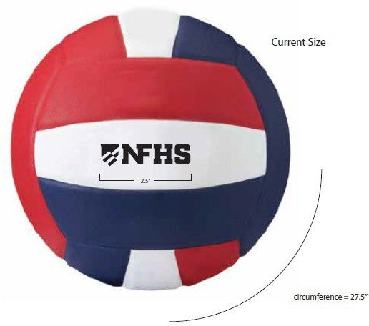
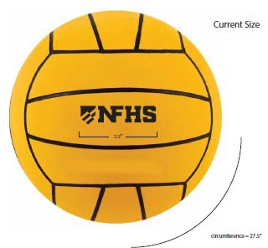
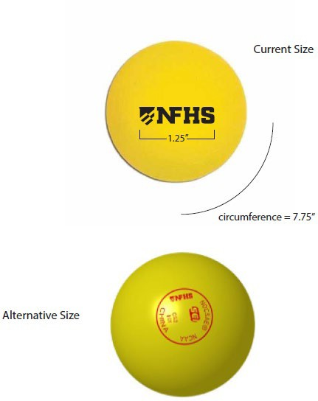
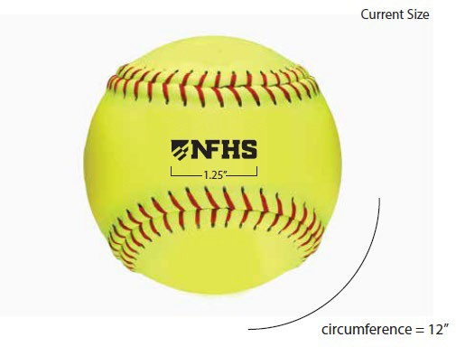
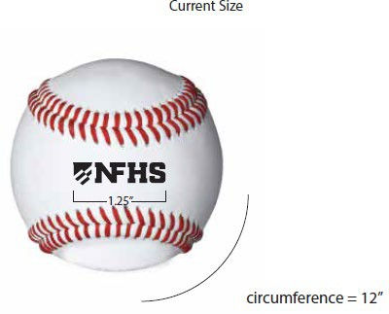
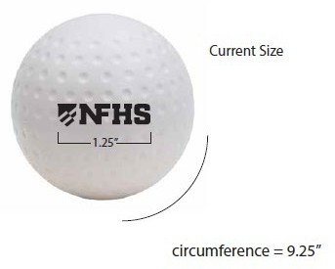
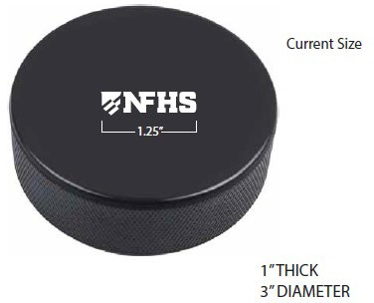
NFHS Authenticating Mark Update
A current list of NFHS authenticated products can be found at www.nfhs.org, Resources, Authenticating Mark.

Slide 54
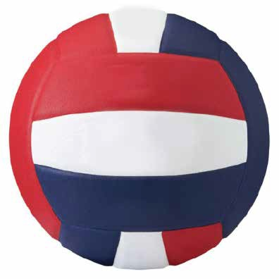


Volleyball
Old Size
Current Size
1.25”
2.5”

Slide 55
Thank You
NFHS.org Phone # 317-972-6900 Email: latkinson@nfhs.org

