Slide 1
Fall administrator workshop
2023-2024

Slide 2


Slide 3


Slide 4


Slide 5


Slide 6
*OSAA Contact Information
Peter Weber - peterw@osaa.org
Kyle Stanfield - kyles@osaa.org
Kris Welch - krisw@osaa.org
Missy Smith - missys@osaa.org
Kelly Foster - kellyf@osaa.org
Monica Maxwell - monicam@osaa.org
Steve Walker - stevew@osaa.org
Chris Burkhardt- chrisb@osaa.org
Candy Posey - candyp@osaa.org
Randi Davis- randid@osaa.org
Heidi Lopez - heidil@osaa.org
Kathi Fetch - kathif@osaa.org
Gibby Reynolds - gibbyr@osaa.org
Jack McFarland - jack@osaasp.com
Connor Heintz - connor@osaasp.com

Slide 7
governance

Slide 8
Governance
*Executive Board
*Delegate Assembly
*Calendar of Meetings
*District Committees

Slide 9
Major rule changes

Slide 10
*Constitution
Full Membership Dues
Diversity, Equity, and Inclusion Advisory Committee
Awards – Name, Image, and Likeness (NIL)

Slide 11
Major Rule Changes Cont.
Endowment Games
Jamborees
Basketball Shot Clock
Officials Fee Schedule

Slide 12
certifications and eligibility

Slide 13
Certification
Athletic Director and Coaches
    Interscholastic Coaching Course (Once)
    Concussion Recognition and Management (Annually)
    NFHS Heat Illness Prevention (Every 4 years)
    Anabolic Steroids and Performance-Enhancing Substances (Every 4 years)
    OSAA Interrupting and Preventing Discriminatory Acts (Once)
    Cheer & Dance/Drill – Spirit Safety Clinic Certification (Annually)
    OSAA Football Certification (Annually)
Notes:
Beyond the Scoreboard – Interscholastic Coaching Course

Slide 14
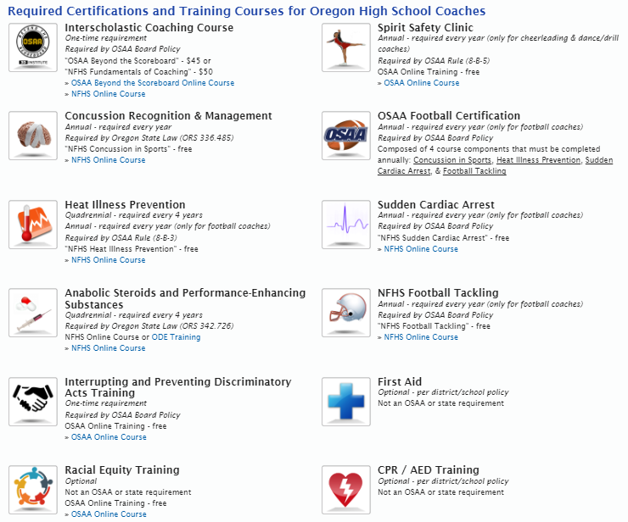
Notes:
All certifications required prior to assuming coaching duties, paid and volunteer
FUNDAMENTALS – Required once, not about X’s and O’s, basics of education based activities
CONCUSSION TRAINING – State law, required annually, recommend NFHSLearn.com course, about 30 minutes and trackable using SYNC feature on OSAA Manage Staff page, updated for 2018-19
HEAT ILLNESS PREVENTION – Required every 4 years (football every year); must use NFHSLearn.com course and trackable using SYNC feature on OSAA Manage Staff page, updated for 2018-19
STEROIDS / PERFORMANCE ENHANCING SUBSTANCES – State law, required every four years; recommend NFHSLearn.com course, about 20 minutes and trackable using SYNC feature on OSAA Manage Staff page
SPIRIT SAFETY CLINIC – Required annually for all cheer and dance coaches, online course hosted by OSAA, trackable using SYNC feature on OSAA Manage Staff page, this year’s course available starting Tuesday, August 7
HEADS UP FOOTBALL – Required annually of all football coaches (paid and volunteer); includes Concussion, Heat, Sudden Cardiac, Blocking/Shoulder Tackling/Equipment Fitting, online through NFHSLearn.com and trackable using SYNC feature on OSAA Manage Staff page
The Football Ad Hoc Committee is looking at recommending changes in this area, primarily to the Player Safety Coach annual requirement

Slide 15
ACADEMIC Eligibility
Previous Grading Period
Current Grading Period
*Satisfactory Progress Toward Graduation
E-mail peterw@osaa.org academic eligibility only requests
  Include plan for academic recovery

Slide 16
Previous / Current Grading Period
Number of Classes Offered | Minimum Number Passed | Minimum Credits Earned
4 | 3 | 1.5
5 | 4 | 2.0
6 | 5 | 2.5
7 | 5 | 2.5
8 | 5 | 2.5
Notes:
1st Prong
Students must have been enrolled full time and passed the appropriate # of classes/ credits during the previously transcripted grading period (3/4, 4/5, 5/6, 5/7, 5/8)
2nd Prong
Likewise, students must be currently enrolled full time and passing the appropriate # of classes / credits
Classes vs. Credits – note that passing 5 classes but for only 2.0 credits doesn’t meet the minimum requirement
Credits earned in summer school may be added to the transcript and counted toward the Spring grading period
Remember to work with your counselors to inform them of this policy, especially for seniors. Students need to be full-time students in order to be academically eligible to participate in OSAA activities.
Academically ineligible students may practice, up to the school
With all the different ways that students can earn credits in today’s educational environment, don’t hesitate to reach out to our office for help and clarification

Slide 17
Minimum Satisfactory Progress
Credits to Graduate | 24 | 25 | 26 | 27 | 28 | 29 | 30
Credits Per Year | 6 | 6 | 6.5 | 6.5 | 7 | 7 | 7.5
Required Prior to Year 2 (75%) | 4.5 | 4.5 | 4.5 | 5.0 | 5.0 | 5.0 | 5.5
Required Prior to Year 3 (85%) | 10.0 | 10.5 | 11.0 | 11.0 | 11.5 | 12.0 | 12.5
Required Prior to Year 4 (95%) | 17.0 | 17.5 | 18.5 | 19.0 | 19.5 | 20.5 | 21.0
Notes:
3rd Prong
The 3rd prong is being on track to graduate per this chart:
Students must be on track prior to the start of the school year or they are ineligible for the entire school year
If a student isn’t on track, but makes up credits during the Fall term to get back on track, they are still not eligible. You will need to file a hardship request.

Slide 18
School Representation
Associate Member Students
  *School Representation Eligibility Certificate
Home School Students
  School Representation Eligibility Certificate
  *Home School Eligibility Parent Checklist
High School Equivalency Students
  School Representation Eligibility Certificate
  *High School Equivalency Parent Checklist
Notes:
Associate Member Students – don’t attend your school but live in your school’s attendance boundary and would like to play for you; paperwork must be filled out prior to them participating
Make sure the school is registered with OSAA as an Associate Member
Eligible at their resident public school only
CHANGE THAT WENT INTO EFFECT LAST YEAR: public charter school students must be allowed to participate per legislation (have to live in your attendance boundary, public charter school must pay a fee to the school of participation)
Ask questions on back of certificate too, nothing worse than having to forfeit contests due to a student that doesn’t even go to your school
Home School Students – law passed in 1994 allows home school students to participate
Must be registered with ESD and live in your attendance boundaries
Must have passed an approved test by August 15 each year (except incoming frosh)
Difference between home schooled and schooled at home
Checklist is a great tool, form has been updated with the approved tests listed

Slide 19
Transfer Students
*Student Intent to Transfer Certificate
*Eligible Student Transfer Certificate
*International Student Eligibility Checklist
Eligibility Request Form – Online Only
Notes:
Transfer Students – paperwork for all transfers, eligible and ineligible
Student Intent to Transfer – protects student from affiliation only, doesn’t confirm eligibility; intended to inform the student’s current school and potential new school that the student plans to transfer, thereby allowing the student to receive instruction from that point forward without jeopardizing eligibility with an affiliation issue
It doesn’t mean that the student is eligible; it doesn’t mean the current school supports the transfer; it doesn’t mean the student is locked in to transferring and can’t change their mind; it simply means the student intends to transfer, no more and no less
Eligible Student Transfer Certificate –ask questions on the back of the form to help figure out if it fits OSAA policies, keep on file at your school
International Students – allows students on approved CSIET program to participate
Checklist questions allow you to determine eligibility, contact us if not sure
Hardships go directly to OSAA using the same online Eligibility Request Form
Eligibility Request Form – for ineligible student with circumstances beyond their control
School has to support the initial request and complete form online
All ineligible transfer requests go to your District Athletic Committee (DAC), even those with grade or on track to graduate deficiencies, DAC rules on all of it
Remember that not every student that is ineligible deserves to be eligible; circumstances beyond the control of each of the student and student’s parents

Slide 20
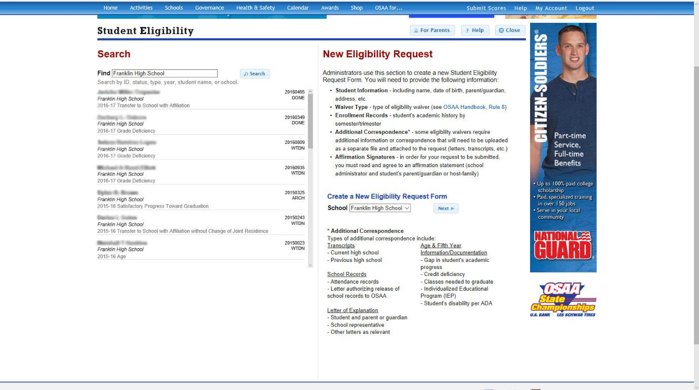

Notes:
Academic Hardship Requests
Academic requests come directly to the OSAA, to the Executive Director
Will work with you and the students but need to see something from them showing they are committed to getting the job done
1st question asked: What did the student accomplish in summer school?
2nd question asked: What is the plan for this student to get back on track to graduate on time?
Make sure the student has shown you that they are willing to put in the effort and do the work prior to sending in a hardship
We all know that participation is good for kids but handing them eligibility without them earning it, doesn’t do them any good in the long run
Will take you through filling out an Eligibility Request form during the regular session

Slide 21
Pre-Participation Physical Exams
State Law
  Required every two years for grades 7-12
    Typically grades 7, 9, & 11
Form available in 12 languages
New form required May 2024
Notes:
Pre-Participation Physical Exam Form
State law, required physical every two years grades 7-12, typically 7, 9, 11 years
New form adopted in April 2023 must be used for any new physicals after May 2024
Available in 12 languages
Mental health resources added (QR code)

Slide 22



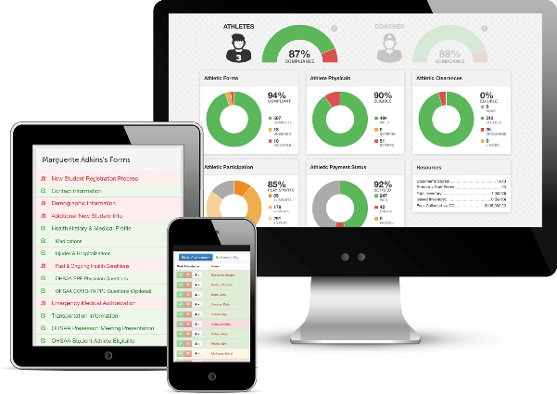
T E A M . T E C H N O L O G Y . S E R V I C E .
Building relationships with leaders.
Dedicated to elevating education
with registration, communication,
and data governance solutions.
“A reputation of selfless service.”
– The General Assembly of the State of Ohio. Ohio Senate.
Notes:
Good morning!
FinalForms turns 10 this year, in July.
For the first 5 or 6 years of the business, we were on a trajectory of discovery and survival. We learned a ton about our industry and the niche that we could serve, and faced down some scary times like a state mandate against us when we had just a dozen clients.
The past 2-3 years, we went through adolescence. We imagined, strategized, and executed on a company structure that is sustainable and poised for rapid growth.
Like a 1000 piece jigsaw puzzle, I feel we've sorted out and pieced together all the coherent sections. We've finished the mountain line, the sunset, that turtle shaped cloud, the lake, the wildflower patch, the smoky cabin, etc etc. Likewise, we have our teams, directors, org charts, SOPs, hubspot, rippling, Github, Slack, Google Drive, accounting firm, law firm, and more, all serving a purpose.
In 2022, we apply the glue.

Slide 23

THE REASON WE’RE TOGETHER…
To see how we can work
together to simplify
registration, communication,
and compliance at OSAA
member schools.
Notes:
Imagine a funnel. Right now, you have an unfiltered fuel intake. Polluted fuel flows in… lands in your offices, an creates mountains of work.
Your member schools have problems too… They’re all...
Operating on shoestring budgets
Working extraordinary hours
Depending on your leadership to “tell them what to do”
As you probably realize, the polluted fuel affects the satisfaction of your member schools, your employees, and, in the end, your athletes.

Slide 24

LET’S DISCUSS YOUR NEEDS…
What do you like about…
Registration
Physical Tracking
Parent Communication
Coach Management
What do you not like?
What do you dream about?
Notes:
Imagine a funnel. Right now, you have an unfiltered fuel intake. Polluted fuel flows in… lands in your offices, an creates mountains of work.
Your member schools have problems too… They’re all...
Operating on shoestring budgets
Working extraordinary hours
Depending on your leadership to “tell them what to do”
As you probably realize, the polluted fuel affects the satisfaction of your member schools, your employees, and, in the end, your athletes.

Slide 25

THE GAME PLAN
1. Service update
2. Range of services
3. Track record
4. Your unique circumstance
5. A solution
6. What’s next?
Notes:
Imagine a funnel. Right now, you have an unfiltered fuel intake. Polluted fuel flows in… lands in your offices, an creates mountains of work.
Your member schools have problems too… They’re all...
Operating on shoestring budgets
Working extraordinary hours
Depending on your leadership to “tell them what to do”
As you probably realize, the polluted fuel affects the satisfaction of your member schools, your employees, and, in the end, your athletes.

Slide 26






1. SERVICE UPDATE
• 1,581 customers • 5 state athletic associations
• 5,256 schools
• 1,217,324 students
• 273,163 athletes
• 196,678 staff
• 97,899 coaches
• NIAAA (Members & Awards)
• 41,737 administrators
• 36 state AD associations + NEDC
• 2 superintendent associations
• 3 coach associations
© 2023. BC Technologies Company. All Rights Reserved.

Slide 27

2. RANGE OF SERVICES
• Registration (Collect, Verify, Distribute)
• Communication (Auto, Manual, Email, Text)
• Compliance (Forms, Certifications)
• Rosters (Attendance, Buses, Team Mgmt)
• Reports (Demographics, Injuries, etc.)
• “Data Backbone”
Notes:
Imagine a funnel. Right now, you have an unfiltered fuel intake. Polluted fuel flows in… lands in your offices, an creates mountains of work.
Your member schools have problems too… They’re all...
Operating on shoestring budgets
Working extraordinary hours
Depending on your leadership to “tell them what to do”
As you probably realize, the polluted fuel affects the satisfaction of your member schools, your employees, and, in the end, your athletes.

Slide 28

3. TRACK RECORD
• Co-Founded in 2012, and fully-owned, by a coach and an athlete
• Serve OHSAA (OH), WIAA (WA), MHSA (MT), and NIAA (NV)
• Serve NIAAA (USA) and 40 State AD associations
• 99.2% retention of customers since 2012
• 93.3% satisfaction with our support team
• Recognized by the Ohio Senate
“A coach and business owner that positively impacts
the operations of athletic departments…
building a reputation of selfless service.”
– The General Assembly of the State of Ohio. Ohio Senate.
Notes:
Imagine a funnel. Right now, you have an unfiltered fuel intake. Polluted fuel flows in… lands in your offices, an creates mountains of work.
Your member schools have problems too… They’re all...
Operating on shoestring budgets
Working extraordinary hours
Depending on your leadership to “tell them what to do”
As you probably realize, the polluted fuel affects the satisfaction of your member schools, your employees, and, in the end, your athletes.

Slide 29

4. YOUR UNIQUE CIRCUMSTANCE
• You need a tool to simplify registration, improve stakeholder communication, increase compliance, reduce risk, controversy,
and liability… and maybe even to automate processes!
• The system must collect, verify, and distribute
information without creating more work.
• Everything must be documented.
Notes:
Imagine a funnel. Right now, you have an unfiltered fuel intake. Polluted fuel flows in… lands in your offices, an creates mountains of work.
Your member schools have problems too… They’re all...
Operating on shoestring budgets
Working extraordinary hours
Depending on your leadership to “tell them what to do”
As you probably realize, the polluted fuel affects the satisfaction of your member schools, your employees, and, in the end, your athletes.

Slide 30

5a. OUR SOLUTION - Deliverables
• White Glove Service
The FinalForms ABCs provide guidance at every step
• Your Needs, Your Forms, Your School: Customization
You’re unique… we get it!
• A Dashboard
Form, signature, and compliance statuses
• A Database
Filer, email, and txt parents, students, & staff
• Security, Privacy, and Interoperability
Compliance with state and national standards
Notes:
Imagine a funnel. Right now, you have an unfiltered fuel intake. Polluted fuel flows in… lands in your offices, an creates mountains of work.
Your member schools have problems too… They’re all...
Operating on shoestring budgets
Working extraordinary hours
Depending on your leadership to “tell them what to do”
As you probably realize, the polluted fuel affects the satisfaction of your member schools, your employees, and, in the end, your athletes.

Slide 31

6. NEXT STEPS
• The FinalForms ABCs
Act Provide Quote (How many athletes do you have?) & Sign Agreement
Build Create Custom-Built Forms and Site
Communicate Conduct Site Review Call
Provide Content for Staff, Parents, Students
Train Admins and Staff
Deploy Launch!
Elevate Continuing Education & Feature Updates
• Timeline
Agree upon rollout schedule and launch date
Notes:
Imagine a funnel. Right now, you have an unfiltered fuel intake. Polluted fuel flows in… lands in your offices, an creates mountains of work.
Your member schools have problems too… They’re all...
Operating on shoestring budgets
Working extraordinary hours
Depending on your leadership to “tell them what to do”
As you probably realize, the polluted fuel affects the satisfaction of your member schools, your employees, and, in the end, your athletes.

Slide 32
Let’s Work Together!
Clay Burnett
CEO, Co-Founder
clay@finalforms.com
440-225-9689
www.finalforms.com/oregon

Slide 33
updates

Slide 34
updates
*State Championship Calendar
*Seasonal AD Checklists
*Ejection Free Schools
*Testing Memo
Notes:
Calendar
- Sherwood Soccer
Football all semis and finals are on the same weekend

Slide 35
updates
*Title IX Education
*New AD / Athletic Assistant Workshops
OSAA Foundation
Corporate Partners

Slide 36




















Corporate partners
Title Partner
Academic All-State
Scholar Program
Toyota Athlete of the Week
Most Valuable Teammate
Leadership Workshops
Les Schwab Team of the Month
Player of the Game / Athlete of the Meet
OSAA Cup
OSAAtoday
Official State Championships Merchandise

Slide 37
Activity information

Slide 38
Practice Limitation rule (6A, 5A, 4A)
Closed Period: August 14 – September 24
  Optional conditioning is the only activity allowed between out-of-season coaches and students from their high school (including freshmen)
  No sport-specific activities permitted
  No Open Facilities allowed
Open Period: September 25 – November 12
  Limited to a maximum of six hours each week per program, not per student (including Open Facilities)
  Allows optional, fundamental skill development with an unlimited number of student-athletes. No 8th graders or students from other schools may participate
  No competition or tryouts permitted

Slide 39
Practice Limitation rule (3a, 2a, 1a)
No Open or Closed Period
  Optional Activities Allowed:
    General conditioning and strength training
    Open Facilities with no direct instruction
Rule of Two: two students, per program, per day
  Receive specialized athletic instruction
  Applies to all coaches, paid or volunteer
  May include optional competition
Baseball/Softball Pitching Exception
  Two weeks prior to the start of the season

Slide 40
Practice model
Single Practice Session
  No longer than three hours, including warm-up and cool down
  Maximum of one hour of weight training either before or after practice
Multiple Practice Sessions
  No more than five hours of total practice, including warm-up and cool down.
  No single practice session shall be longer than three hours, including warm-up and cool down.
  At least three hours of recovery time between practice sessions
  During recovery time, students may not engage in other physical activities (e.g., weight training, etc.).
Notes:
What you can do on a single practice day

Slide 41
Practice model cont.
Multiple Practice Sessions – Teaching Sessions
  One practice session of the first two multiple practice days shall be a teaching session only. Conditioning drills (gassers, timed runs, or sprints) shall not be conducted.
  The intensity, duration, and pace of all practice components shall be modified from a normal practice session.
  The focus should be directed at developing skills fundamental to the sport at a significantly reduced pace.
  Practice components in all activities intended to develop skills while conditioning the athlete at the same time are not allowed.
Notes:
Further explains a “teaching session”
In Football, light contact with bags is allowed but Live Action situations are prohibited. Coaches are encouraged to use this “teaching session” to address offensive and defensive strategies, skill development drills and other types of team building activities that do not involve conditioning.
Walk throughs

Slide 42
Volleyball
Required warm up protocol
  20 minute minimum: 4’ shared (remain on your side of the net), 8’ for Visiting Team, 8’ for Home Team.
2023 UNIFORM CHANGE: Body of number must contrast jersey, not just the outline of the number.
Assistants allowed to stand during dead ball situations
Final Site ball color change (red, white, and navy)

Slide 43
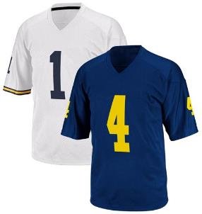
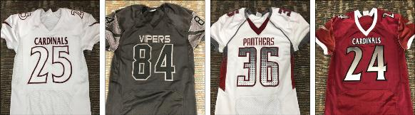
Football
Bracket Modifications 1A[6]
5A Football Participation Limitation
  Six quarters allowed per week
Uniform change effective 2024
  Numbers must contrast with body

Slide 44
basketball
:35 Shot Clock required at varsity level starting 2023-24 season
  Optional for sub-varsity
Shot Clock – Survey Results

Slide 45
wrestling
14 Weight Classes
  Boys: 106, 113, 120, 126, 132, 138, 144, 150, 157, 165, 175, 190, 215, 285
  Girls: 100, 105, 110, 115, 120, 125, 130, 135, 140, 145, 155, 170, 190, 235
Six matches per day
  No more than 10 matches over two days
Participation Limitations Aligned
Girls Bracket Expansion
TrackWrestling Reminders

Slide 46
tennis
4A/3A/2A/1A - Special District 4

Slide 47
Baseball
One-way communication now allowed between coach and catcher

Slide 48
Softball
Pitcher may disengage from the mound
Softball Ball Standards
  Balls manufactured with the former specifications will be permitted through 2024, to allow for manufacturers and schools to reduce current inventory. The new ball specifications will be required by January 1, 2025.
Notes:
While pushing off from the pitching plate both feet may be disengaged from the playing surface as long as they remain within the 24-inch width of the pitching plate and do not create a replant of the pivot foot resulting in the pitcher being further away from the pitcher’s plate. Pushing off with the pivot foot from a place other than the pitcher's plate resulting in the non-pivot foot becoming closer to home plate is illegal.

Slide 49
Emerging activities
Boys Volleyball
Girls Flag Football
Esports
Notes:
-Working with the EB to clarify our role with emerging sports
Boys Volleyball: Going to DA in October to be voted in as an Emerging Sport
Girls Flag: teams in spring 2023, looking to expand in spring 2024. Uniform stipend provided by Nike. Contact Kelly for more information
Esports: OSAA has a preferred partner if you are interested – contact OSAA
Special Olympics will be adding Unified Track and Field – more information to come Webinar

Slide 50
Committees / task forces /
Board Agenda

Slide 51
Diversity, equity, & inclusion
Roster additions
Complaint process
  Most received in football, soccer and basketball
S.T.A.R. School application
  Have a plan and take action
Additional educational resources coming

Slide 52
Student Advisory Council
Nominations for open roster spots coming out in the Fall

Slide 53
Petition to play down TASK FORCE
Reviewing current policies
Exploring different/additional criteria
  Criteria for schools wanting to remain down
Beginning Fall of 2023
Completed by April 2024

Slide 54
Championship thresholds TASK FORCE
Review of qualification percentages for individual & team sports
Reviewing the minimum number of programs to have championships in activities
Beginning Spring of 2024

Slide 55
Sports medicine advisory
Emergency Action Plan Campaign
*Sports Medicine Reminders
  Heat Index Policy
  Air Quality Guidelines
Notes:
There will be more information in the coming days regarding the Emergency Action Campaign
- emphasis on the ACTION piece of it
Attachment includes the Sports Medicine Reminders that includes links to our guidelines and policies
Kris will cover subscribing to the Heat Index Alerts
AirNow Fire and Smoke Map, OregonAir app on your phone 151 and above – no outdoor participation

Slide 56
September executive Board Agenda items
Special District Adoptions
  Spring Sports
  Boys & Girls Wrestling
Reimbursement Formula
Football Ad Hoc – Required Information

Slide 57


2023 OSAA Workshops
Notes:
Update with GoFan + Network logos

Slide 58





Offer for Schools
2 FREE PIXELLOT UNITS FOR MAIN GYM AND FIELD AND FREE INSTALLATION
NO COST – upfront or ongoing, including equipment, software, installation, and maintenance
REVENUE SHARING STARTS YEAR 1 – no waiting period
NO EXCLUSIVITY REQUIREMENT – we are relaxing the exclusivity provision for regular season events
INCREASED REVENUE SHARE OPPORTUNITY FOR EXCLUSIVE BROADCASTING SCHOOLS
213
73%
SCHOOLS WITH PIXELLOTS
OSAA SCHOOLS

Slide 59


Role of Customer Success
As we work to deliver a unified platform, we will also provide our schools with a dedicated CSM to manage and grow the relationship across all PlayOn Sports products.
Customer Success is setup for the relationship with schools.
Ross Lawrence is your dedicated CS manager.
Onboard
Introductions
Application Training (post install)
Education
Renewal
Cancellation
Expand
Contractual
Health
Advertising
Community Awareness
New user training
Best Practices
Revenue Insights
Additional Events
Additional Cameras
Vidswap
Feature Awareness
Viewership
Account Review
Feedback
Broadcast Quality
Middle Schools
Goal Setting
General Questions

Slide 60
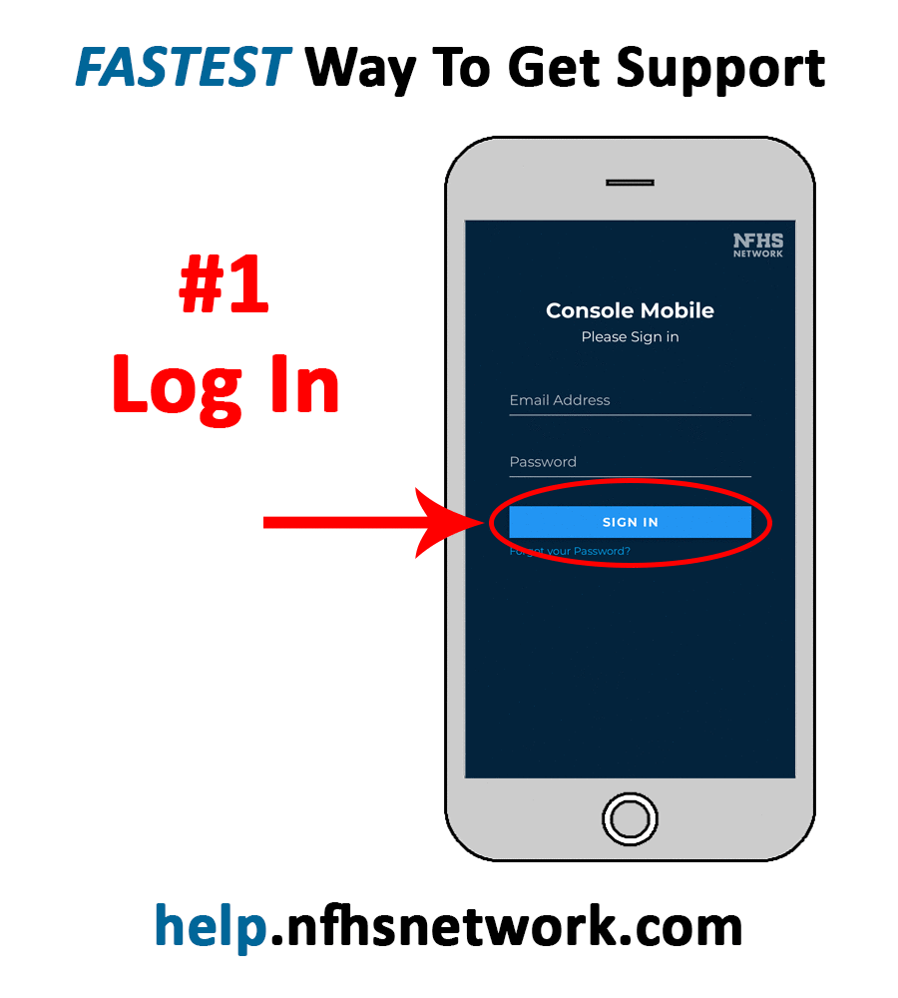
Role of Customer Experience (Support)
Customer Experience (Event Support)
Setup to be responsive and provide quality resolution
What’s new…
  New leadership and upskilled staff
  New tools allowing us to proactively diagnose and address issues
  Improving our paths to providing assistance
Need assistance during a live event? Use Console Mobile
Go to help.nfhsnetwork.com
Log in* with your Console credentials
Click the yellow GET HELP button and fill out form
*If unsure of login info, click “Forgot Password” and enter your work email
In addition to submitting support tickets, Console Mobile can also be used to:
Monitor Pixellot Systems
Run Test Broadcasts
Change Event Times
Start & Stop Broadcasts

Slide 61



Canopy – Pixellot Management Tool
Canopy is a new fleetwide management tool we are using to monitor Pixellot units. It allows us to be more proactive, rather than reactive.
Canopy has allowed us to identify Pixellots with internet issues. Some can be resolved via remote, and others we’ll need to partner with the schools for resolution. Canopy will continue to monitor every unit on a daily basis to keep the fleet healthy.
Internet Status
Are firewalls impacting connections? Is there IP connectivity?
Power Status
Reboots were a big issue last year. Multiple processes that were creating the reboots unnecessarily have been repaired.
Is the unit on? If the unit is shut off, has it come back on?
Camera Status & Accuracy
We are now able to be more proactive and identify Pixellots that have camera issues ahead of time.
Is the camera online & paired to the VPU.

Slide 62

Contact Us
Regional Sales Manager
Rebecca Stewart
Rebecca.stewart@playonsports.com
(404) 216-2276
Schedule a Meeting with Rebecca

Slide 63
OSAA website

Slide 64
Affiliated associations

Slide 65
Oregon Athletic Coaches Association
Executive Director:
Associate Director:
Office Manager:
Phone:
Email:
Rob Younger
Chris Knudsen
Laura Erickson
(541) 928 - 2700
oacarob@gmail.com
www.oregoncoach.org
OACA Digital Gold Card
Online Membership is available
Coaches Recruitment & Retention Campaign
Serving Oregon Coaches since 1935!

Slide 66
2023-24 oaca clinic dates
Volleyball Clinic: August 11; Westside Christian HS
Soccer Clinic: August 12; LaSalle HS
Basketball Clinic: October 13; Wilsonville HS
Nike NW Track & Field: February 2-3; Nike Campus, Beaverton
Nike/OACA Football Clinic: March 1-3; Sheraton Portland Airport
Clinic Information/Registration: www.oregoncoach.org
Mentoring Training: Recruitment/Retention
Thursday, August 3, 7:00 PM at Mt. View HS
Sunday, August 6, 3:00 PM at Pacific Office Automation
Sunday, August 13, 1:00 PM at North Medford HS

Slide 67
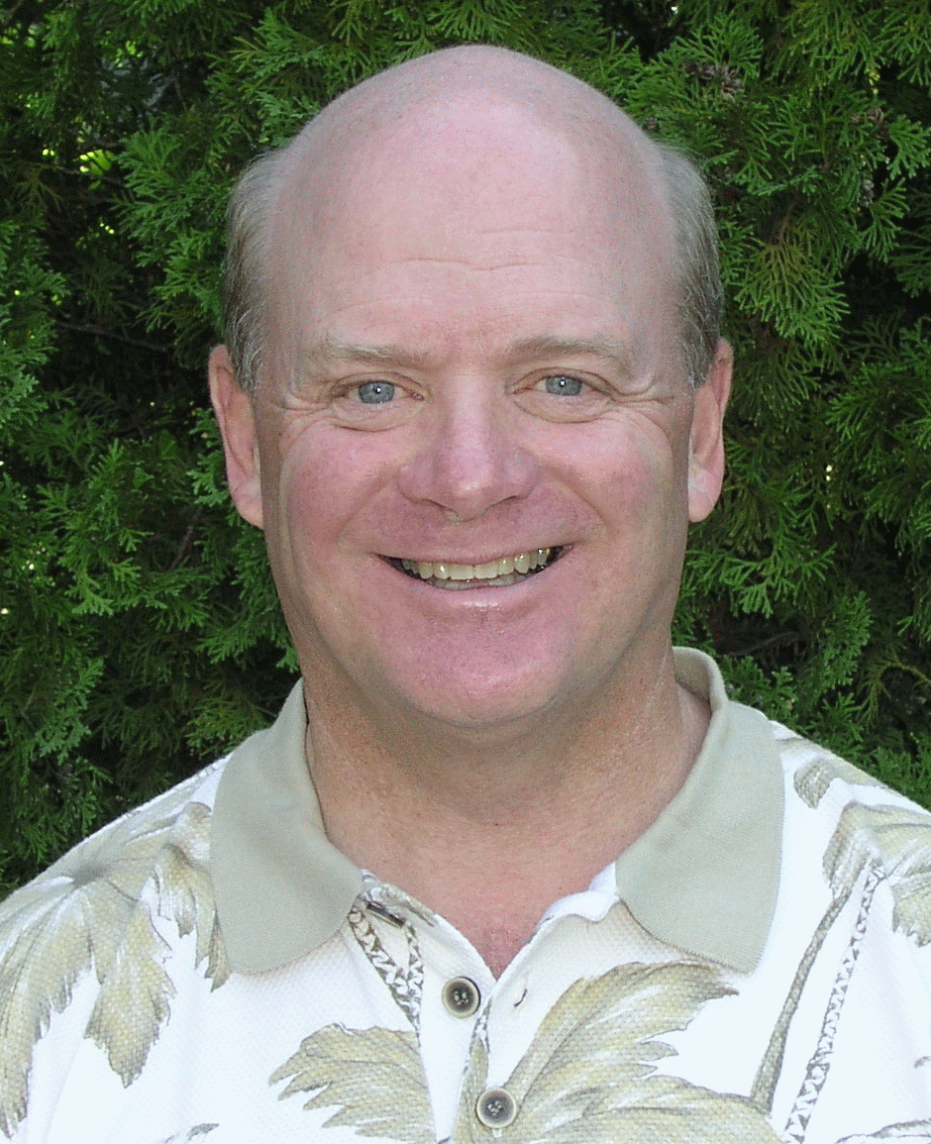
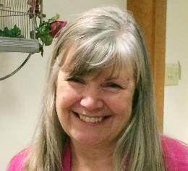
Oregon Athletic Officials Association
Jack Folliard
Executive Director
Email: jfolliard@comcast.net
(503) 975 - 4488
Debi Hanson
Associate Director
Email: debi@oreofficials.org
(503) 704-0121
www.oreofficials.org
Dedicated to the Advancement of High School Officiating in Oregon
“One Rule…One Mechanic…One Interpretation”

Slide 68
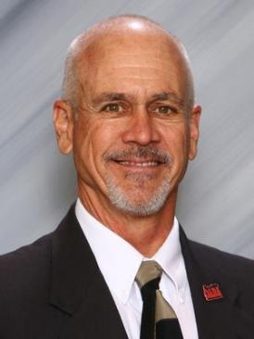




Oregon Athletic Directors Association
Dave Hood, CAA
Executive Director
Retired AD
Ph. (541)280-1114
Email: hoody.oada@gmail.com
www.oadaonline.org
Oregon Athletic Directors
Association
@OregonADs
oregonathleticdirectors

Slide 69
2023-24 OADA Board Officers
President/ OSAA Liaison – Anna Maria Lopez, St. Mary’s Academy
President-Elect – Trent Kroll, CMAA, Sherman County
Vice President – Shelley Moore, CAA, Newport HS
Secretary – Jessica Russell, Benson Tech HS
Past-President – Doug Thompson, Forest Grove HS
LTI/CAA Test Coordinator– Tim Sam, CMAA, North Valley HS
Mentor Coordinator – Dennis Burke
DEI Liaison – John Matsuo, Hillsboro HS
Retired Representative – Mike Henderson, CAA
Treasurer – Toni Cowdrey, North Central ESD

Slide 70
2023-24 Classification Representatives
6A Rep – Ryan McIrvin, McMinnville HS
5A Rep – Salvador Muñoz, Corvallis HS
4A Rep – Darren Shryock, Stayton HS
3A Rep – Angela Davis, Corbett HS
2A Rep – Lorena Woods, Stanfield Secondary
1A Rep – Steve Wallo, CAA, CS Lewis Academy

Slide 71
Who is your LEAGUE REP this year (2023-24)?
Please let your Classification Representative know soon!!

Slide 72
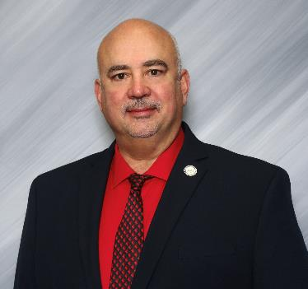
Leadership Training Institute
& Certification Testing Coordinator
Coordinates all LTI Courses
Coordinates State Faculty
Coordinates LTI Testing Program
Maintains LTC/Test Records
Tim Sam, CMAA, N. Valley HS
tim.sam@threerivers.k12.or.us

Slide 73
Certifications available:
RAA (Registered Athletic Administrator)
RIAA (Registered International Athletic Administrator)
RMAA (Registered Middle School Athletic Administrator)
CAA (Certified Athletic Administrator)
CIAA (Certified International Athletic Administrator)
CMAA (Certified Master Athletic Administrator)

Slide 74
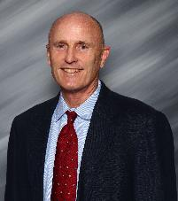
New Athletic Director
Mentorship Program
All new AD’s (year 1-3) will be paired with a veteran AD
Coordinated by Dennis Burke - through your OADA League Representative or
Classification Rep
AD Toolbox on OADA Website

Slide 75

State Ambassador Program
Bring ADs together to become significant leaders in their schools & communities
ADs and Admin receive very little intentional leadership training. We are expected to know how to lead. Great leadership occurs only when people are committed to their own continual improvement.
Coordinated by Pete Lukich, CAA & Tom Bendt
Express interest here

Slide 76
Membership OADA & NIAAA
Yearly Dual Membership - $130
Registration Online (OADA Website)
Membership dues after October 31- $145
For Questions Contact
      Dave Hood– hoody.oada@gmail.com
      www.oadaonline.org/membership

Slide 77
OADA Membership Benefits
NIAAA Leadership Training Institute curriculum of courses taught in OREGON and online
OADA Annual Conference offering workshops, services, information & networking opportunities
Opportunity to serve as member of the League Rep Council, legislative voice of OADA, with direct line of communication to OSAA
Awards program honoring OR Athletic Administrators at the local, state and national level
Hall of Fame induction and recognition of individuals who have strongly impacted the profession of athletic administration
Quarterly newsletters, electronic and print materials to assist the profession
Mentorship Program for new ADs
Opportunities to serve on OADA committees
Extra Liability ($1,000,000) and Accident Insurance

Slide 78

NIAAA Membership
Membership Benefits
  The Interscholastic Athletic Administrator (IAA) Journal
  The NFHS News
  Professional Development & Certification coursework
  $2,000,000 additional liability insurance
  $2,500 term life insurance
  Discount on registration fees for the NADC National AD Conference
  Opportunities to serve on national committees

Slide 79


OACA Gold Card Membership
Please encourage all your coaches to join (and you)!!!
Membership Benefits
  Offered to all ASEP/NFHS-certified and college coaches. This card entitles the member to Regular Card benefits plus admission to High School and OSAA-sponsored events.
  $2,000,000 additional liability insurance
Register here:
https://www.oregoncoach.org/member-info/registration/

Slide 80

National Conference
54th National Athletic Directors Conference
December 15-19, 2023, Orlando, FL
Register Online at: www.niaaa.org

Slide 81

OADA State Conference
April 12-16^{th,} 2024
Sunriver, Oregon
Registration Cost -$325, after March 20th $375
-$300 w/CAA or CMAA, then $325
-$425 on site at Sunriver

Slide 82
OADA Listserv
Free email subscription service for posting Open Dates and Coaching Openings
Subscribe at the OADA Website Listserv Link (www.oadaonline.org) or directly at mailman.mesd.k12.or.us/mailman/listinfo/adlist
Posted weekly, highly effective, 800+ subscribers
Send to: Kris Welch – oadalistserv@gmail.com

Slide 83





Thank you!
Have a great year!

Slide 84
Final reminders
Update school information on OSAA Website
Subscribe to Heat Index Alerts
Emergency Action Plan
District Committees

