Slide 1

Mentorship
Building a Program in your Local Association
Brad Garrett – OSAA Staff
OAOA Leadership Conference
Eagle Crest Resort – Redmond, OR

Slide 2
“If I have seen further than others, it is by standing on the shoulders of giants.” — Isaac Newton

Slide 3
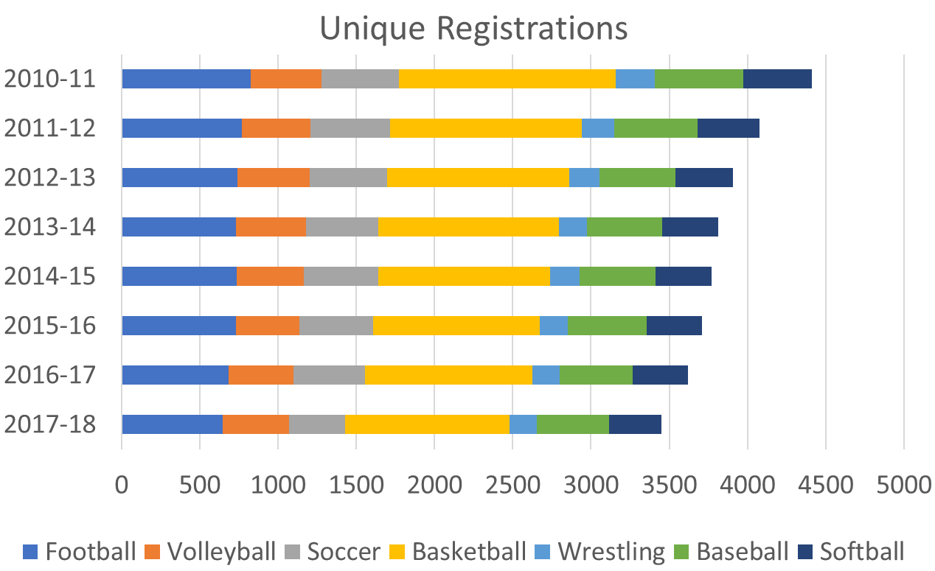
Down
1,000+ Officials

Slide 4
“The Committee has reached consensus that all local associations will have an approved mentorship program in place to begin the 2018-19 school year. Locals will be able to develop their own models but they will be required to contain certain elements that all programs will have in common.”
Excerpt from April 2 meeting update of the OSAA Recruitment and Retention Committee

Slide 5
Why a Mentorship Program?
Creates opportunities to make a difference in someone’s life
Has potential to help the local association to retain officials and increases the chance of recruiting more
Can provide a sense of purpose for veteran membership
Provides opportunities to enhance the overall leadership skills of current membership and shapes leaders of tomorrow

Slide 6
Mentoring
Focus on Progress
Intuitive Feedback
Longer Term
Develops Capabilities
Driven by Mentee
Helps you work it out for yourself
Coaching
Task Oriented
Explicit Feedback
Short Term
Develops Skills
Driven by Coach
Shows you where you went wrong

Slide 7
Section 9. Local associations shall implement a member mentorship program. The mentoring program should be documented in writing and contain the following minimum information (refer to AOH Appendix C for examples of mentoring programs):
  a) Goals and objectives of the mentoring program,
  b) How the mentorship program is administered; i.e. mentoring format, mentor-mentee interactions, etc.,
  c) Qualifications, responsibilities, and expectations of mentors and mentees,
  d) Procedures for mentor-mentee pairing, and
  e) Plan for feedback and evaluation of the mentorship program.

Slide 8
Goals and Objectives
Build and retain membership
Increase communication and knowledge across the local
Create more collaboration opportunities
Increase commitment and a sense of connection
Enhance and promote diversity awareness and understanding

Slide 9
Program Administration
Who is responsible to coordinate the program?
What type of structure has been selected – traditional, team, group?
What are the basic ground rules for all pairings – length of commitment, length and frequency of meetings?
How will success be measured?

Slide 10
Mentor Qualification
Where you are, I have been. Where I am, you can go
Willing to embrace challenges
Can model appropriate behavior and ethics
Has the respect of the membership

Slide 11
Mentor Responsibilities and Expectations
Provide “real-world” training
Embrace challenges
Model appropriate behavior and ethics
Provide a link to the “network”

Slide 12
Mentee Responsibilities and Expectations
Eagerness to learn
Ability and willingness to work as a team player
Patience
Be a risk taker
Have a positive attitude

Slide 13






Mentor –Mentee Pairing Format
Traditional
Group
Peer to Peer
Team

Slide 14
Mentor – Mentee Pairing Criteria
Similar background (racial, ethnic, cultural, or linguistic)
Language requirements
Geographic location
Availability/schedule
Shared or compatible interests
Mentee’s needs and strengths
Mentor’s skills and strengths
Life experience
Shared values
Temperament
Personality traits
Program goals
Mentoring experience

Slide 15
Feedback and Evaluation
Pre and post surveys for mentors and mentees
Focus groups
Direct observations

Slide 16
Additional Resources
Appendix C of the 2018-19 AOH will have an example of a local association mentoring program that meets the criteria listed in Section 9.
The Recruitment tab at www.osaa.org/officials - will be adding content moving forward to this page. Templates, Best Practices, Surveys, Links to Alternate sites.
A Google search on “Mentor Program” produced 163,000,000 potential resources.

Slide 17
Thank you!

